Slide 1
CONTAINERS

Slide 2

WHAT ARE CONTAINERS?
It Depends Who You Ask
INFRASTRUCTURE
APPLICATIONS
Application processes on a shared kernel
Simpler, lighter, and denser than VMs
Portable across different environments
Package apps with all dependencies
Deploy to any environment in seconds
Easily accessed and shared

Slide 3
VIRTUAL MACHINES AND CONTAINERS
VIRTUAL MACHINES
CONTAINERS
VM
Container
Container
Container
Container
App
App
App
App
App
App
App
App
OS Dependencies
OS deps
OS deps
OS deps
OS deps
Kernel
Container Host (Kernel)
Hypervisor
Hardware
Hardware
virtual machines are isolated
apps are not
containers are isolated
so are the apps
Notes:
Organizations have traditionally co-located multiple applications on a single virtual machines due to the operational overhead and resource costs of maintaining VMs.
Although VMs are isolated from each other however co-located applications have zero isolation and can negatively impact each other files, configurations and behaviour.
Linux containers share a container host and kernel and at the same time using kernel technologies such as cgroups, SELinux and kernel namespaces provide isolation so that one container cannot access or impact neither the other containers running on the same host nor the host itself.
Linux containers are in a way a virtualization technology. VMs are for virtualizing the hardware while containers are for virtualizing application processes no matter where they run (bare metal, virtualized or cloud)

Slide 4
VIRTUAL MACHINES AND CONTAINERS
Virtual Machine
Container
Application
Application
OS dependencies
OS dependencies
Operating System
Container Host
VM Isolation
Complete OS
Static Compute
Static Memory
High Resource Usage
Container Isolation
Shared Kernel
Burstable Compute
Burstable Memory
Low Resource Usage
Notes:
Although possible to run every application on a single virtual machine, the operational overhead and resource cost of the multitude of extra VMs required generally invalidates the perceived benefits
Virtual machines have the advantage of providing hypervisor-level isolation for the application. However that comes at the cost of running a complete operating system for each application which consumes more memory and cpu. Furthermore, VMs compute and memory capacity is pre-defined and do not provide any elasticity or bursting more when an application requires more memory or computing power.
Containers provide isolation through taking advantage of kernel technologies like cgroups, kernel namespaces and SELinux which have been battle-tested and used for years at Google and US Department of Defense to provide application isolation
Since containers use a shared kernel and container host, they reduce the amount of resources required for the container itself and are more lightweight than virtual machines. Therefore, containers provide an unmatched agility that is not feasible with virtual machines for example it only takes a few seconds to start a new container. Furthermore, containers support a more flexible model when it comes to compute and memory resources and allow resource burst modes so that applications can consume more resources when required within the defined boundaries.

Slide 5
VIRTUAL MACHINES AND CONTAINERS
Virtual Machine
Container
Application
Clear ownership boundary between Dev and IT Ops drives DevOps adoption and fosters agility
Application
Dev
IT Ops (and Dev, sort of)
OS dependencies
OS dependencies
Operating System
Container Host
IT Ops
Infrastructure
Infrastructure
Optimized for stability
Optimized for agility
Notes:
DevOps adoption skyrocketed in the last few years which coincides with the proliferation containers in the IT industry. This in fact is not a coincidence and containers have played an important role in enabling organizations to implement DevOps without the obstacles once faced with virtual machines.
With virtual machines being the unit of compute, applications are developed by Dev teams and the result is delivered as arbitrary packages (which usually varies between teams and applications) to the IT Ops teams which are responsible for building, deploying and managing the virtual machine, operating system, libraries and application dependencies and the application itself. This essentially creates a conflictory atmosphere between Dev, IT Ops and other teams involved in delivering applications since IT Ops is forced into ownership of undocumented and non-standard layers of the technology stack (in other words the application and its dependencies) that they are not familiar with and have to rely on vague instructions from the Dev teams.
When containers are used as a unit of compute, there is a clear boundary between the layers of technology stack that IT Ops and Dev teams own and manage. Dev teams are deeply familiar with the application they build as well as its dependencies and configurations. With containers, they own the application and its configuration and package the result as a container image. The container images are delivered to IT Ops as a standard package regardless of the technologies used to build the application. IT Ops owns the entire infrastructure (container host, virtualisation, etc) for running standard container images and can deploy, monitor and manage containers across multiple infrastructure using standard procedures without the need for adaptation for every application.
Using containers, Dev and IT Ops teams can work at different speeds, upgrade and downgrade servers and applications independently of each other, and easily move applications between different environments.
The clear ownership boundary allows Dev and IT Ops to work seamlessly during the application delivery cycles and lays the ground for enabling DevOps across organizations.

Slide 6





APPLICATION PORTABILITY WITH VM
Virtual machines are NOT portable across hypervisor and do NOT provide portable packaging for applications
Guest VM
VM Type X
VM Type Y
VM Type Z
Application
Application
Application
Application
Application
OS dependencies
OS dependencies
OS dependencies
OS dependencies
OS dependencies
Operating System
Operating System
Operating System
Operating System
Operating System
LAPTOP
BARE METAL
VIRTUALIZATION
PRIVATE CLOUD
PUBLIC CLOUD
Notes:
Although there has been efforts to standardize the virtual machine format, it never succeeded and the virtual machine technology is highly tied to the hypervisor. For example when using VMware, the VMs on-premise are tied to vSphere whereas in a public cloud such as Amazon Web Services they are tied to AWS hypervisors.
Moving an application to other infrastructure such as bare metal, other hypervisors, private and public clouds would require rebuilding the applications technology stack from scratch based on the chosen infrastructure and redoing all verifications on the previous infrastructure.
The industry is going toward immutable infrastructure to simplify deployment and management of software. Using VMs as the packaging unit for applications, requires you to build a new VM every time that there is a change and ship that to your infrastructure. Netflix is the best example of this approach. When they needed to make a change in production, they had to bake that change in a new VM (AWS AMI) and ship the VM to production. Interestingly Netflix states that they would have taken a different approach, had linux containers ecosystem at that time been as mature as it is today.

Slide 7
APPLICATION PORTABILITY WITH CONTAINERS
Guaranteed Portability Across Any Infrastructure
Container
Container
Container
Container
Container
Application
Application
Application
Application
Application
OS dependencies
OS dependencies
OS dependencies
OS dependencies
OS dependencies
RHEL
RHEL
RHEL
RHEL
RHEL
Guest VM
Virtual Machine
Virtual Machine
Virtual Machine
LAPTOP
BARE METAL
VIRTUALIZATION
PRIVATE CLOUD
PUBLIC CLOUD
Notes:
Container provide application portability due to the standard image format (Open Container Initiative) and the fact that they are only dependent on Linux. This gives teams better control over the infrastructure where they deploy applications. A container host provides a common ground for running containers on any infrastructure from your own laptop, to bare metal, virtualization, private and public clouds.
Nevertheless, portability does not guarantee compatibility. Portability is often believed to mean that you can take a container image and run it on any container host built from any Linux distribution, but this is not technically accurate. Linux container images are collections of files, including libraries and binaries, which are specific to the hardware architecture and operating system. When the container image is run, the binaries inside the image run just like they would on a normal Linux operating system. There must be compatibility between the container image and container host. For example, you cannot run 64-bit binaries on a 32-bit host.
These inconsistencies can range from sporadic failure, which is hard to debug, to complete failure where the container will not run at all. Worse, incompatibilities can lead to performance degradation or security issues. Portability of Linux containers is not absolute—using different Linux distributions, or widely differing versions of the same Linux distribution, can lead to serious problems.
In order to guarantee portability and compatibility, it is a best practice to run a consistent version and distribution of Linux in all containers and on all container hosts across environments and infrastructure. This guarantees compatibility both horizontally and vertically.
OCI-standard containers combined with the a standard container host like Red Hat Enterprise Linux provides a portable and compatible application delivery combination that guarantees your applications run the exact same way across all environments and infrastructure.
Immutability is also one of the key benefits of OCI standard container images without being tied to a specific machine image format like you are with VM images such as AMI on AWS. That’s why you see even Netflix adopting containers to enable the same CD workflows but now in a more portable and efficient manner.

Slide 8
RAPID SECURITY PATCHING USING CONTAINER IMAGE LAYERING
Image Layer 3
Application Layer
Image Layer 2
Java Runtime Layer
Image Layer 1
OS Update Layer
Base Image
Base RHEL
Container Image Layers
Example Container Image
Notes:
A container image is typically made up of multiple layers.
The first image is called a base image, and it includes everything necessary to get started.Teams often work by building their own layers on these base images. Users can also build on more advanced application images, which not only have an operating system but also include language runtimes, debugging tools, and libraries.
Base images are built from the same utilities and libraries included in an operating system. A good base image provides a secure and stable platform on which to build applications. Red Hat provides base images for Red Hat Enterprise Linux. These images can be used like a normal operating system. Users can customize them as necessary for their applications, installing packages and enabling services to start up just like a normal Red Hat Enterprise Linux Server.
Red Hat also provides more advanced application images that already include extra software. Examples include language runtimes, databases, middleware, storage, and independent software vendor (ISV) software. Software included in these images is tested, pre-configured and certified to work out of the box. These pre-built images make it easy to deploy multi-tier applications from existing components without the work of building your own application images.
The layering structure significantly simplies patching procedures since a layer needs to be patched only once and then any image built using that layer would contain the applied patch
Container platforms like OpenShift have the ability to track existing containers that use a certain layer and if patched, trigger a series of image builds and deploys for existing and running containers in order to apply the patched layer across all containers and prevent security breaches.

Slide 9
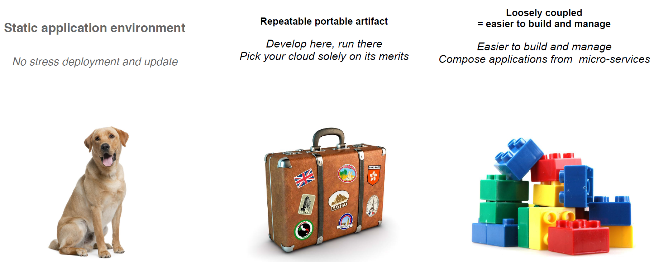
What’s is a Containers
9

Slide 10
Dockerfile, Docker Image & Container
FROM rhel:7.5
RUN curl http://download.oracle.com/jdk-8u131-linux-x64.tar.gz
RUN tar –zxvf jdk-8u131-linux-x64.tar.gz
RUN curl http://mirrors.jenkins.io/war-stable/latest/jenkins.war
COPY plugin.sh /jenkins/
EXPOSE 8080
ENTRYPOINT ["/bin/tini", "--", "/usr/local/bin/jenkins.sh"]
THIN CONTAINER LAYER (RW)
ENTRYPOINT [“/bin/tini”, …..]
EXPOSE 8080
23d768bs.......
COPY plugin.sh /jenkins/
34dstrsc .......
RUN curl jenkins-2.4.62
CONTAINER
876ghtrsc .......
RUN curl oracle-jdk-8.131.11.tgz
56fhrxce43 .......
READ ONLY IMAGE LATERS
FROM rhel:7.5
45tgvb467 .......
91e54dfgc .......
10
Notes:
Each Docker image references a list of read-only layers that represent filesystem differences. Layers are stacked on top of each other to form a base for a container’s root filesystem.
The Docker storage driver is responsible for stacking these layers and providing a single unified view.
When you create a new container, you add a new, thin, writable layer on top of the underlying stack. This layer is often called the “container layer”. All changes made to the running container - such as writing new files, modifying existing files, and deleting files - are written to this thin writable container layer.
Container VS Image
The major difference between a container and an image is the top writable layer. All writes to the container that add new or modify existing data are stored in this writable layer. When the container is deleted the writable layer is also deleted. The underlying image remains unchanged.
Because each container has its own thin writable container layer, and all changes are stored in this container layer, this means that multiple containers can share access to the same underlying image and yet have their own data state.

Slide 11



Why container ?
Package software into standardized units for development, shipment and deployment
A container is a lightweight, stand-alone, executable package of a piece of software that includes everything needed to run it: code, runtime, system tools, system libraries, settings.
Available for both Linux and Windows based apps, containerized software will always run the same, regardless of the environment.
Containers isolate software from its surroundings, and help reduce conflicts between teams running different software on the same infrastructure.
Lightweight &
Agile
Standardized &
Portable
Security &
Isolation
Containers share host machine's operating system kernel; they start instantly and use less compute and RAM.
Containers are constructed from file system layers and share common files. This minimizes disk usage and image downloads are much faster.
Containers are based on open standards and run on all major Linux distributions, Microsoft Windows, and on any infrastructure including VMs, bare-metal and in the cloud.
Containers isolate applications from one another and from the underlying infrastructure.
Containers provides the strongest default isolation to limit app issues to a single container instead of the entire machine.
The ability to easily and atomically update and scale individual component of application stack is the only way to improve security, scalability, and hardware utilization.
Containers turn apps into integral units that can migrate easily between machines and between providers
VM-focused workflow ties the OS directly to the apps on the box. Moving dependencies out of the OS and into a container dramatically reduces complexity.
11
Notes:
For software owners:
Consistent way to package code
Efficient way to distribute software
Portability between platforms
For infrastructure owners:
Standard way to deploy software
Standard interfaces to orchestrate software
Removes need to have deep knowladge of the software to deploy and manage them

Slide 12
What is Kubernetes & why ?
We need more than just packing and isolation
What is Kubernetes
Scheduling: Where should my containers run?
Lifecycle and health: Keep my containers running despite failures, upgrade/rollback
Discovery: Where are my containers now?
Isolation: keep my jobs from interfering with each other
Auth{n,z}: Control who can do things to my containers
Aggregates: Compose sets of containers into jobs
Scaling: Making jobs and cluster bigger or smaller
Security: Continuously scan container images for security vulnerabilities.
Provenance: How do I know that the software I’ve downloaded or been given really comes from a trusted party.
Load balancing: Distribute traffic across a set of containers
Provisioning Storage: Provide data to containers
Logging and monitoring: Track what’s happening with my containers
Debugging, introspection, late-binding configuration: Enter or attach to containers
Datacenter-scale operating system
Reduces: overhead, attack surface, complexity, infrastructure spend
Improves: code deployment time, flexibility, Ops efficiency, portability, fault tolerance
Declarative deployment model lets you “set and forget” infrastructure and app state
12

Slide 13
OPENSHIFT ARCHITECTURE

Slide 14

YOUR CHOICE OF INFRASTRUCTURE
PHYSICAL
VIRTUAL
PRIVATE
PUBLIC
HYBRID
Notes:
Speaker:
* From bare metal physical machines to virtualized infrastructure, or in private or certified public clouds, OpenShift is supported anywhere that Red Hat Enterprise Linux is.
* This includes all the supported virtualization platforms - RHEV, vSphere or Hyper-V.
* Red Hat’s OpenStack platform and certified public cloud providers like Amazon, Google and more are supported, too.
* You can even take a hybrid approach and deploy instances of OpenShift Container Platform across all of these infrastructures.
Discussion:
* Show the flexibility of deploying OpenShift
* Technically only x86 platforms are supported.
Transcript:
OpenShift is fully supported anywhere Red Hat Enterprise Linux is. Hybrid deployments across multiple infrastructures can be achieved, but many customers are still adopting OpenShift inside their existing, traditional virtualized environments.

Slide 15
NODES RHEL INSTANCES WHERE APPS RUN
NODE
NODE
NODE
RHEL
RHEL
RHEL
NODE
NODE
NODE
RHEL
RHEL
RHEL
PHYSICAL
VIRTUAL
PRIVATE
PUBLIC
HYBRID
Notes:
Speaker:
* OpenShift has two types of systems. The first are called nodes.
* Nodes are instances of RHEL 7 or RHEL Atomic with the OpenShift software installed.
* Ultimately, Nodes are where end-user applications are run.
Discussion:
* The Nodes are what the Masters will orchestrate - you will learn about Masters shortly.
* Nodes are just instances of RHEL or Atomic.
* OpenShift’s node daemon and other software runs on a node.
Transcript:
OpenShift can run on either RHEL or RHEL Atomic. Nodes are just instances of RHEL or Atomic that will ultimately host application instances in containers.

Slide 16




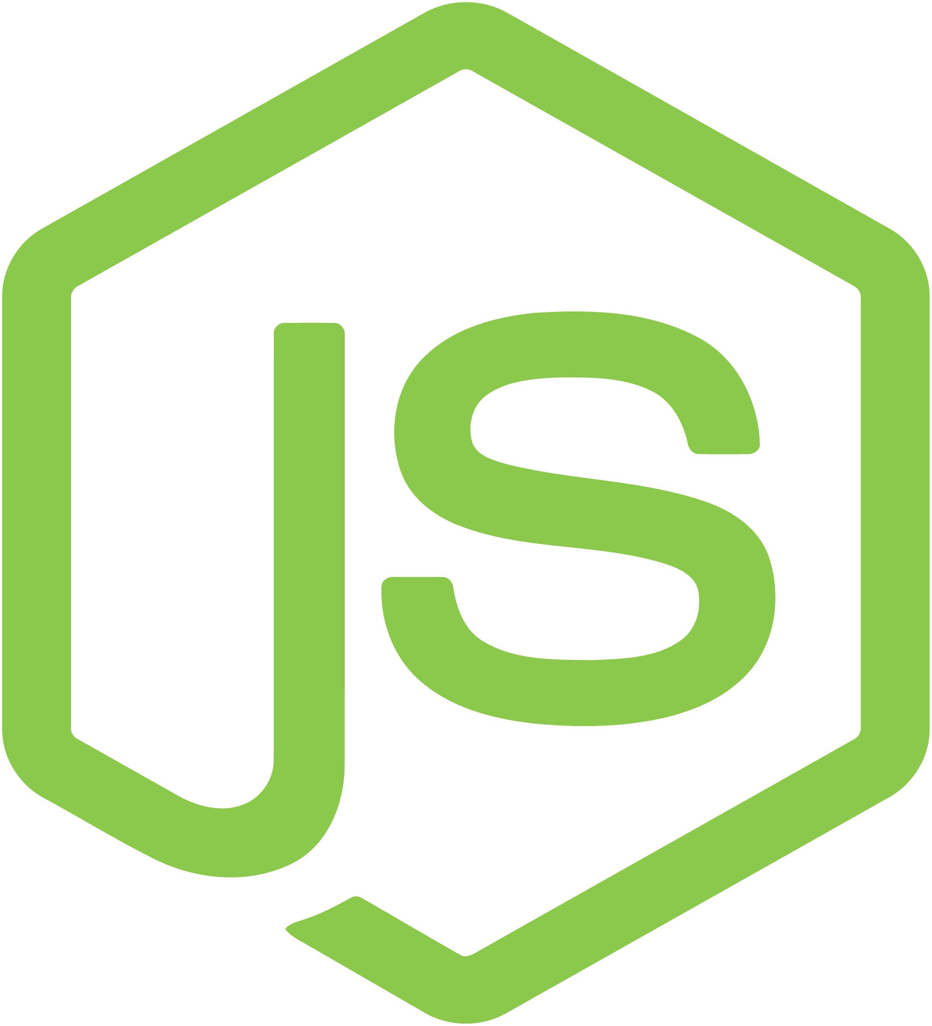

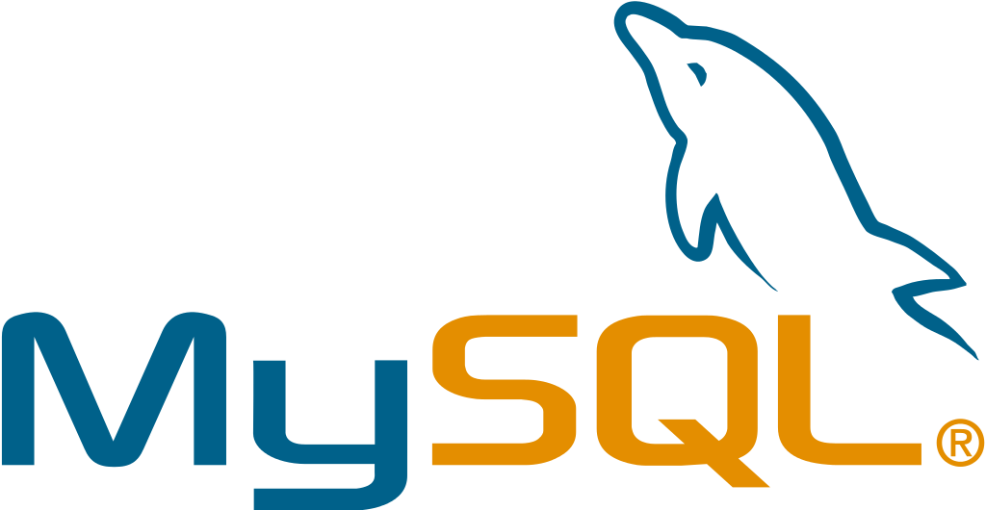

APPS RUN IN CONTAINERS
NODE
NODE
NODE
Container Image
C
C
c
C
C
C
Container
RHEL
RHEL
RHEL
NODE
NODE
NODE
C
C
C
C
Pod
C
RHEL
RHEL
RHEL
Notes:
Speaker:
* Application instances and application components run in linux containers. Linux container technologies are lightweight mechanisms for isolating running processes so that they are limited to interacting with only their designated resources. Many application instances can be running in containers on a single host without visibility into each others' processes, files, network, and so on.
* Containers in OpenShift are based on Docker-formatted container images. An image is a binary that includes all of the requirements for running a single container. Container images can be thought of as a packaging technology.
* Each OpenShift Node can run many containers
* A Pod is one or more containers deployed together as if they were deployed on one host and encapsulates storage resources and a unique network IP. Pod is the smallest unit that can be defined, deployed, and managed in OpenShift. A Pod might consist of either a single container or a small number of containers that are tightly coupled and that share resources.
Discussion:
* A node’s capacity is related to the memory and CPU capabilities of the underlying “hardware”
Transcript:
All of the end-user application instances and application components will run inside linux containers on the nodes. RHEL instances with bigger CPU and memory footprints can run more containers.

Slide 17
PODS ARE THE UNIT OF ORCHESTRATION
NODE
NODE
NODE
C
C
c
C
C
C
RHEL
RHEL
RHEL
NODE
NODE
NODE
C
C
C
C
C
RHEL
RHEL
RHEL
Notes:
Speaker:
* While app components run in Docker containers, the “unit” that OpenShift is orchestrating and managing is called a Pod
* In this case, a Docker image is the executable or runnable components, and the container is the actual running instance with runtime and environment parameters
* One or more containers make up a Pod, and OpenShift will schedule and run all containers in a Pod together
* Complex applications are made up of many Pods each with their own containers, all interacting with one another inside an OpenShift environment
Discussion:
* OpenShift consumes Docker Images and runs them in containers wrapped by the meta object called a Pod.
* The Pod is what OpenShift schedules, manages and runs.
* Pods can have multiple containers but there are not many well-defined use cases
* Services, described soon, are how different application components are “wired” together. Different application components (eg: app server, db) are not placed in a single Pod
Transcript:
OpenShift can use any native Docker image, and schedules and runs containers in a unit called a Pod. While Pods can have multiple containers, generally a Pod should provide a single function, like an app server, as opposed to multiple functions, like a database and an app server. This allows for individual application components to be easily scaled horizontally.

Slide 18
MASTERS ARE THE CONTROL PLANE
RED HAT
ENTERPRISE LINUX
NODE
NODE
NODE
MASTER
RHEL
RHEL
RHEL
NODE
NODE
NODE
RHEL
RHEL
RHEL
PHYSICAL
VIRTUAL
PRIVATE
PUBLIC
HYBRID
Notes:
Speaker:
* The other type of OpenShift system is the Master
* Masters keep and understand the state of the environment and orchestrate all activities on the Nodes
* Masters are also instances of RHEL or Atomic, and multiple masters can be used in an environment for high availability
* Masters can be treated like any nodes and have apps deployed on them. However it is recommended to dedicate Masters to management processes and mark them as non-schedulable for application containers.
* Masters have four primary jobs or functions
Discussion:
* The OpenShift Master is the orchestrator of the entire OpenShift environment.
* The OpenShift Master knows about and maintains state within the OpenShift environment.
* Just like Nodes, Masters run on RHEL or Atomic
* You will discuss the four primary functions of the Master in the next slides
Transcript:
Just like Nodes, the OpenShift Master is installed on RHEL or Atomic. The Master is the orchestration and scheduling engine for OpenShift, and is responsible for knowing and maintaining the state of the OpenShift environment. The Master has four primary functions which you will now describe.

Slide 19
API AND AUTHENTICATION
RED HAT
ENTERPRISE LINUX
NODE
NODE
NODE
MASTER
API/AUTHENTICATION
RHEL
RHEL
RHEL
NODE
NODE
NODE
RHEL
RHEL
RHEL
PHYSICAL
VIRTUAL
PRIVATE
PUBLIC
HYBRID
Notes:
Speaker:
* The Master provides the single API that all tooling and systems interact with. Everything must go through this API.
* All API requests are SSL-encrypted and authenticated. Authorizations are handled via fine-grained role-based access control (RBAC)
* The Master can be tied into external identity management systems, from LDAP and AD to OAuth providers like GitHub and Google
Discussion:
* All requests go through the Master’s API
* The Master evaluates requests for both AuthentacioN (AuthN - you are who you say you are) and AuthoriZation (AuthZ - you’re allowed to do what you requested)
* The Master can be tied into external identity management systems like LDAP/AD, OAuth, and more
* Apache modules can also be used for authentication in front of the API
Transcript:
The Master is the gateway to the OpenShift environment. All requests must go through the Master and must be both authenticated and authorized. A wide array of external identity management systems can be the source of authentication information in an OpenShift environment.

Slide 20
DESIRED AND CURRENT STATE
RED HAT
ENTERPRISE LINUX
NODE
NODE
NODE
MASTER
API/AUTHENTICATION
DATA STORE
RHEL
RHEL
RHEL
NODE
NODE
NODE
RHEL
RHEL
RHEL
PHYSICAL
PHYSICAL
VIRTUAL
VIRTUAL
PRIVATE
PRIVATE
PUBLIC
PUBLIC
HYBRID
HYBRID
Notes:
Speaker:
* The desired and current state of the OpenShift environment is held in the data store which includes all objects such as builds, deployments, services, routes, etc
* The data store uses etcd, a distributed key-value store and stores the persistent master state while other components watch etcd for changes to bring themselves into the desired state.
* Other things like the RBAC rules, application environment information, and non-application-user-data are kept in the data store
Discussion:
* etcd holds information about the desired and current state of OpenShift
* Additionally, user account info, RBAC rules, environment variables, secrets, and many other bits of OpenShift information are held in the data store
* More generally, any OpenShift data object is stored in etcd
Transcript:
Etcd is another of the critical components of the OpenShift architecture. It is the distributed key-value data store for state and other information within the OpenShift environment. Reads and writes of information generally are going to hit the data store.

Slide 21

INTEGRATED CONTAINER REGISTRY
RED HAT
ENTERPRISE LINUX
NODE
NODE
NODE
MASTER
API/AUTHENTICATION
DATA STORE
RHEL
RHEL
RHEL
RHEL
RHEL
NODE
NODE
NODE
REGISTRY
RHEL
RHEL
RHEL
PHYSICAL
VIRTUAL
PRIVATE
PUBLIC
HYBRID
Notes:
A container registry is a service for storing and retrieving Docker-formatted container images. A registry contains a collection of one or more image repositories.
OpenShift Container Platform provides its own internal registry for managing container images.
Red Hat also provides a registry at registry.access.redhat.com for subscribers which is called Red Hat Container Catalog
OpenShift can deploy images from the integrated image registry as well as Red Hat Container Catalog, Docker Hub and any other registry the customer might be using
OpenShift Container Platform registry can also be installed separately as a stand-alone container image registry.

Slide 22
ORCHESTRATION AND SCHEDULING
RED HAT
ENTERPRISE LINUX
NODE
NODE
NODE
MASTER
API/AUTHENTICATION
DATA STORE
RHEL
RHEL
RHEL
RHEL
RHEL
SCHEDULER
NODE
NODE
NODE
REGISTRY
RHEL
RHEL
RHEL
PHYSICAL
VIRTUAL
PRIVATE
PUBLIC
HYBRID
Notes:
Speaker:
* The scheduler portion of the Master is the specific component that is responsible for determining Pod placement
* The scheduler takes the current memory, CPU and other environment utilization into account when placing Pods on the various nodes
Discussion:
* The scheduler is responsible for Pod placement
* Current CPU, Memory and other environment utilization is considered during the scheduling process
Transcript:
The OpenShift scheduler uses a combination of configuration and environment state to determine the best fit for running Pods across the Nodes in the environment.

Slide 23
PLACEMENT BY POLICY
RED HAT
ENTERPRISE LINUX
NODE
NODE
NODE
MASTER
C
C
API/AUTHENTICATION
c
C
C
DATA STORE
RHEL
RHEL
RHEL
SCHEDULER
NODE
NODE
NODE
REGISTRY
RHEL
RHEL
RHEL
PHYSICAL
VIRTUAL
PRIVATE
PUBLIC
HYBRID
Notes:
Speaker:
* The real-world topology of the OpenShift deployment (regions, zones, and etc) is used to inform the configuration of the scheduler
* Administrators can configure complex scenarios for scheduling workloads
Discussion:
* The scheduler is configured with a simple JSON file in combination with node labels to carve up the OpenShift environment to make it look like the real world topology
Transcript:
The topology of the real-world environment is used by platform administrators to determine how to configure the scheduler and the Node labels.

Slide 24
AUTOSCALING PODS
RED HAT
ENTERPRISE LINUX
NODE
NODE
NODE
MASTER
C
C
API/AUTHENTICATION
c
C
C
DATA STORE
RHEL
RHEL
RHEL
SCHEDULER
NODE
NODE
NODE
REGISTRY
HEALTH/SCALING
RHEL
RHEL
RHEL
PHYSICAL
VIRTUAL
PRIVATE
PUBLIC
HYBRID
Notes:
Speaker:
* The Master is responsible for monitoring the number of pods and automatically scaling them as desired
* Pods can be manually scaled stating the number of pods that should be running
* Pods can also be autoscaled based on metrics collected from the pods (cpu utilization) within the boundary of minimum and maximum number of pods that is configured for the autoscaler

Slide 25
SERVICE DISCOVERY
SERVICE LAYER
RED HAT
ENTERPRISE LINUX
NODE
NODE
NODE
MASTER
C
C
API/AUTHENTICATION
c
C
C
C
DATA STORE
RHEL
RHEL
RHEL
SCHEDULER
NODE
NODE
NODE
REGISTRY
HEALTH/SCALING
C
C
C
C
C
RHEL
RHEL
RHEL
PHYSICAL
VIRTUAL
PRIVATE
PUBLIC
HYBRID
Notes:
Speaker:
* OpenShift’s service layer enables application components to easily communicate with one another
* The service layer provides for internal load balancing as well as discovery and code reusability
Discussion:
* The service layer is used to connect application components together
* OpenShift automatically injects some service information into running containers to provide for ease of discovery
* Services provide for simple internal load balancing across application components
Transcript:
OpenShift’s service layer is how application components communicate with one another. A front-end web service would connect to database instances by communicating with the database service. OpenShift would automatically handle load balancing across the database instances. Service information is injected into running containers and provides for ease of application

Slide 26

PERSISTENT DATA IN CONTAINERS
SERVICE LAYER
RED HAT
ENTERPRISE LINUX
NODE
NODE
NODE
PERSISTENT
STORAGE
MASTER
C
C
API/AUTHENTICATION
c
C
C
C
DATA STORE
RHEL
RHEL
RHEL
SCHEDULER
NODE
NODE
NODE
REGISTRY
HEALTH/SCALING
C
C
C
C
C
RHEL
RHEL
RHEL
PHYSICAL
VIRTUAL
PRIVATE
PUBLIC
HYBRID
Notes:
Speaker:
* Applications are only as useful as the data they can manipulate.
* Docker containers are natively ephemeral - data is not saved when containers are restarted or created.
* OpenShift provides a persistent storage subsystem that will automatically connect real-world storage to the right Pods, allowing for stateful applications to be used on the platform.
* A wide array of persistent storage types are usable, from raw devices (iSCSI, FC) to enterprise storage (NFS) to cloud-type options (Gluster/Ceph, EBS, pDisk, etc)
Discussion:
* OpenShift’s persistent volume system automatically connects storage to Pods
* The persistent volume system allows stateful apps to be used on the platform
* OpenShift provides flexibility in the types of storage that Pods can consume
Transcript:
OpenShift’s persistent volume system allows end users to consume a wide array of storage types to enable stateful applications to be run on the platform. Whether OpenShift is running locally in the datacenter or in the cloud, there are storage options that can be used.

Slide 27



ROUTING AND LOAD-BALANCING
ROUTING LAYER
SERVICE LAYER
RED HAT
ENTERPRISE LINUX
NODE
NODE
NODE
PERSISTENT
STORAGE
MASTER
C
C
API/AUTHENTICATION
c
C
C
C
DATA STORE
RHEL
RHEL
RHEL
SCHEDULER
NODE
NODE
NODE
REGISTRY
HEALTH/SCALING
C
C
C
C
C
RHEL
RHEL
RHEL
PHYSICAL
VIRTUAL
PRIVATE
PUBLIC
HYBRID
Notes:
Speaker:
* Not every consumer of applications exists inside the OpenShift platform. External clients need to be able to access things running inside OpenShift
* The routing layer is a close partner to the service layer, providing automated load balancing to Pods for external clients
* The routing layer is pluggable and extensible if a hardware or non-OpenShift software router is desired
Discussion:
* The OpenShift router runs in pods on the platform itself, but receives traffic from the outside world and proxies it to the right pods
* The router uses the service endpoint information to determine where to load balance traffic, but it does not send traffic through the service layer
* The router is built with HAProxy, but is a pluggable solution. Red Hat currently supports F5 integration as another option.
Transcript:
OpenShift’s routing layer provides access for external clients to reach applications running on the platform. The routing layer runs in Pods inside OpenShift, and features similar load balancing and auto-routing around unhealthy Pods as the Service layer.

Slide 28


ACCESS VIA WEB, CLI, IDE AND API
ROUTING LAYER
SERVICE LAYER
RED HAT
ENTERPRISE LINUX
NODE
NODE
NODE
PERSISTENT
STORAGE
SCM
(GIT)
MASTER
C
C
API/AUTHENTICATION
c
CI/CD
C
C
C
DATA STORE
RHEL
RHEL
RHEL
SCHEDULER
NODE
NODE
NODE
REGISTRY
EXISTING AUTOMATION TOOLSETS
HEALTH/SCALING
C
C
C
C
C
RHEL
RHEL
RHEL
PHYSICAL
VIRTUAL
PRIVATE
PUBLIC
HYBRID

Slide 29










CaaS Infrastructure Stack- Current State
Tectonic Management Console
FORD STORAGE SERVICES
Trusted Computing
IAM
Monitoring / Logging
NetApp
OPERATORS
Container cluster manager
Tectonic
Prometheus
etcd
Container Linux
Networking fabric
Distributed key-value store
Container engine
Private container/application registry &
container build system
Operating system
Container vulnerability scanner
29
Notes:
An Operator is an application-specific controller that extends the Kubernetes API to create, configure and manage instances of complex stateful applications on behalf of a Kubernetes user. It builds upon the basic Kubernetes resource and controller concepts, but also includes domain or application-specific knowledge to automate common tasks better managed by computers.
We use Operators because managing stateful applications, like databases, caches and monitoring systems, is a big challenge, especially at massive scale. These systems require human operational knowledge to correctly scale, upgrade and reconfigure while at the same time protecting against data loss and unavailability.

Slide 30
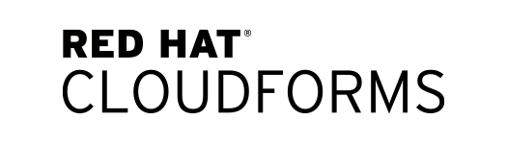


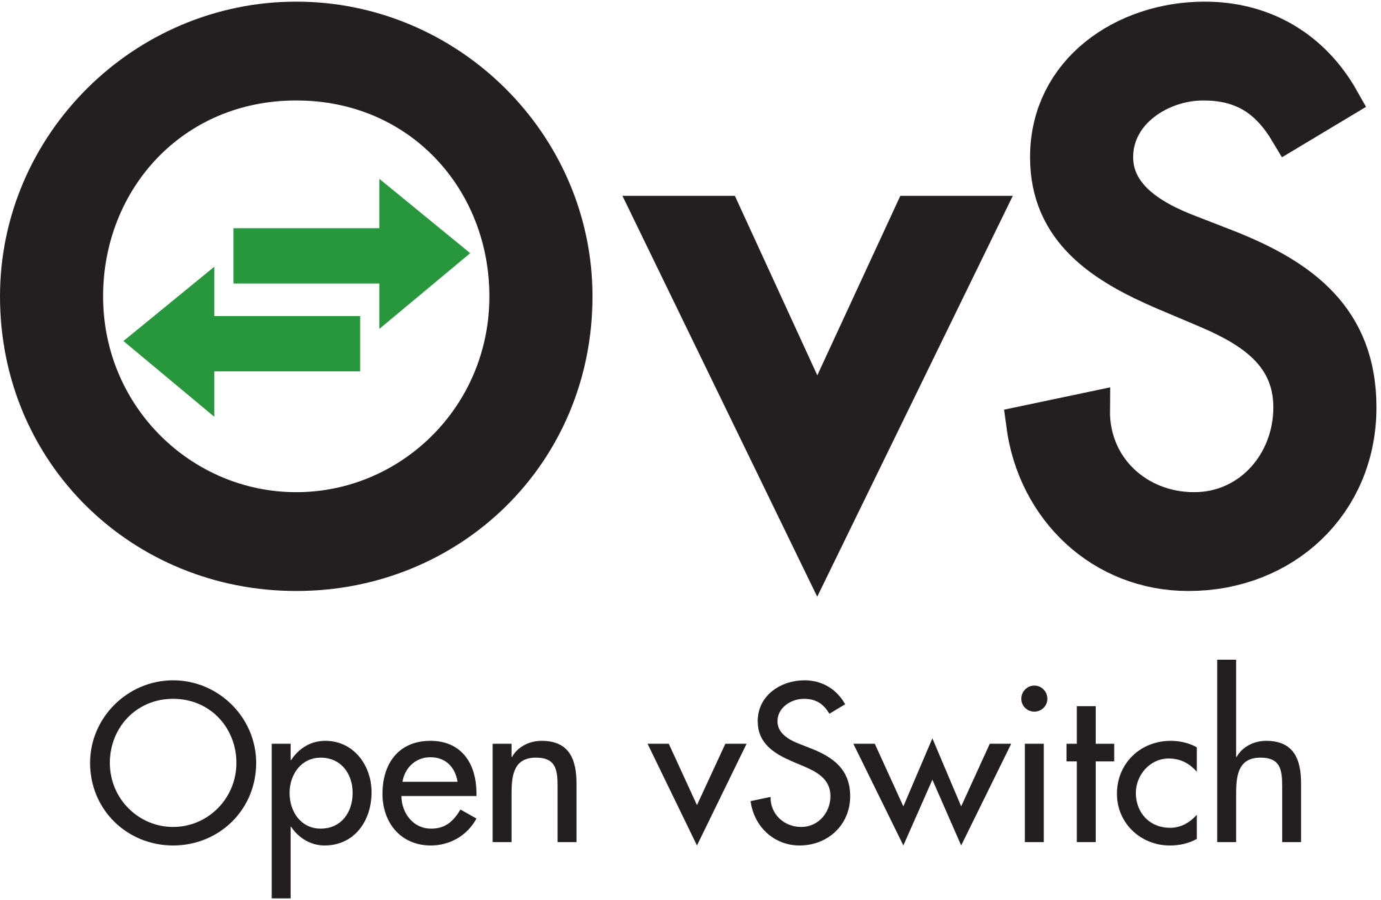


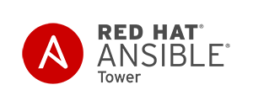

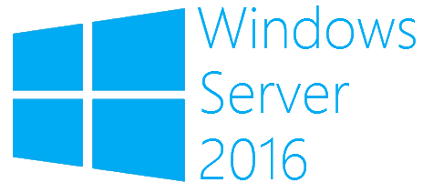
CaaS Infrastructure Stack – Future state
Developer/Management Console - WebUI
TPM
SSO
Monitoring
Logging
CI/CD
Chargeback
Open Service Brokers
Load Balancer
Security
EXTENSIONS
Service Catalog
Container Catalog
Container cluster manager
STORAGE
Networking SDN
RedHat GlusterFS
NetApp Trident
Distributed key-value store
OPERATORS
Kubernetes
Prometheus
etcd
Automated OS Update
Container engine
Automation & Security/Compliance
REGISTRY
Operating system
Private container/application registry &
container build system
PHYSICAL
VIRTUAL
PRIVATE
PUBLIC
HYBRID
Container vulnerability scanner
30
PHYSICAL
VIRTUAL
PRIVATE
PUBLIC
HYBRID
Notes:
An Operator is an application-specific controller that extends the Kubernetes API to create, configure and manage instances of complex stateful applications on behalf of a Kubernetes user. It builds upon the basic Kubernetes resource and controller concepts, but also includes domain or application-specific knowledge to automate common tasks better managed by computers.
We use Operators because managing stateful applications, like databases, caches and monitoring systems, is a big challenge, especially at massive scale. These systems require human operational knowledge to correctly scale, upgrade and reconfigure while at the same time protecting against data loss and unavailability.

Slide 31
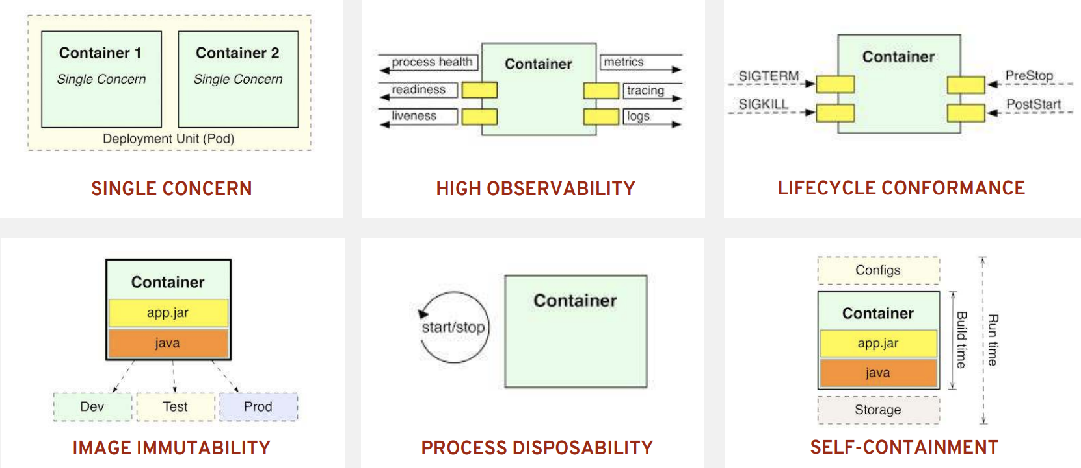
New Possibilities

Slide 32
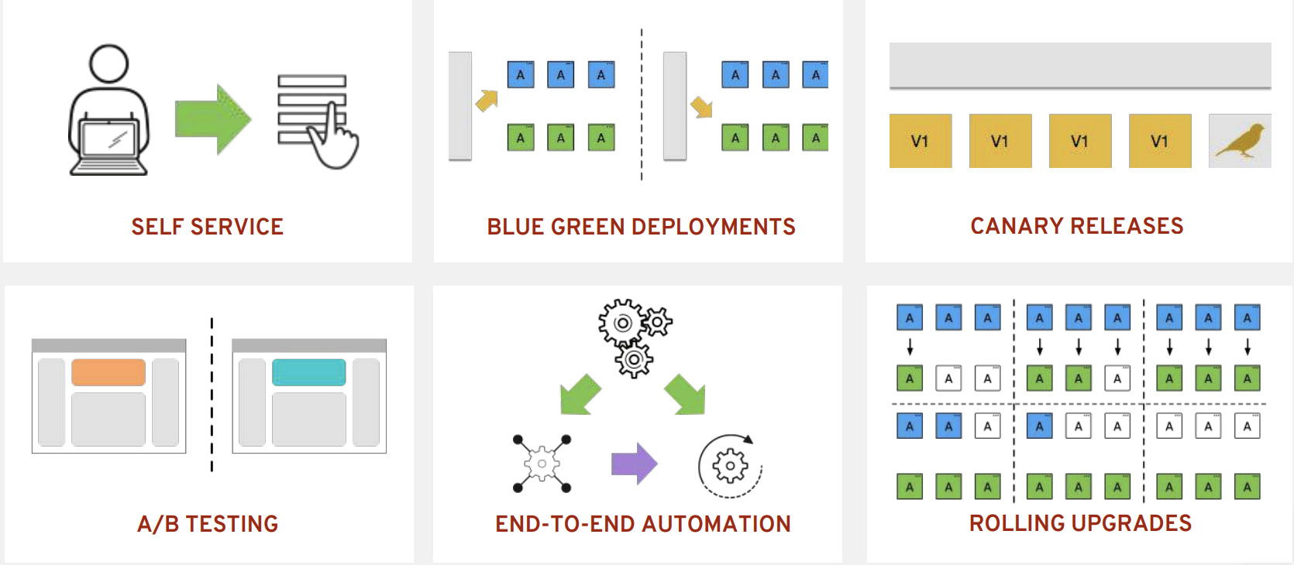
New ways to deliver

Slide 33
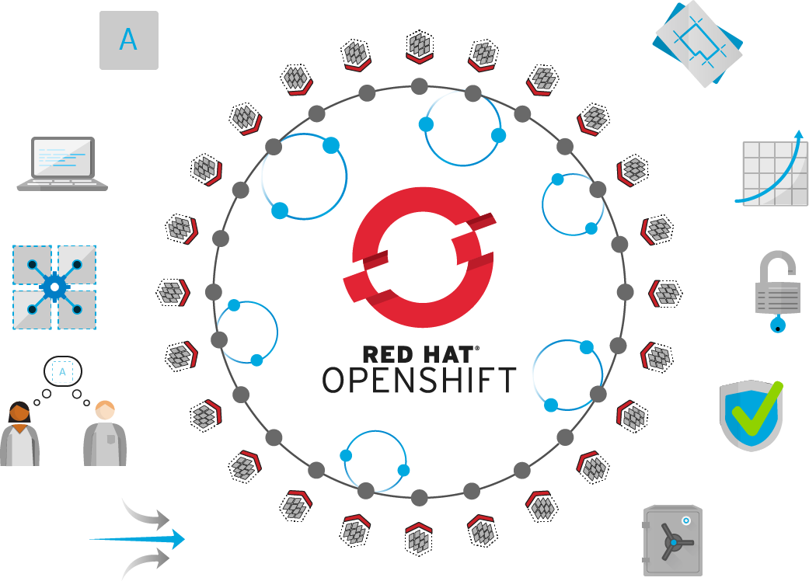
Self-Service
Standards-based
Multi-language
Web-scale
Automation
Open Source
Collaboration
Enterprise Grade
Multi-tenant
Secure
Notes:
Red Hat helps organizations develop, deploy, and manage existing and container-based applications seamlessly across physical, virtual, and public cloud infrastructures.
Built on proven open source technologies, OpenShift helps application development and IT operations teams modernize applications, deliver new services, and accelerate development processes.
OpenShift Container Platform provides developers with an optimal platform for provisioning, building, and deploying applications and their components in a self-service fashion. With automated workflows like our source-to-image (S2I) process, it is easy to get source code from version control systems into ready-to-run, docker-formatted container images.
OpenShift IT operations a secure, enterprise-grade Kubernetes that provides policy-based control and automation for applications. Cluster services, scheduling, and orchestration provide load-balancing and auto-scaling capabilities. Security features prevent tenants from compromising other applications or the underlying host. And because OpenShift can attach persistent storage directly to containers, IT organizations can run both stateful and stateless applications on one platform.

Slide 34
ISVs Are Targeting Containers
Software Ford buys has begun to be shipped as containers.
- For example Oracle, SQL Server 2017, Magneto, MongoDB, Redis
Application
Libraries
config
Containers are more than just a tool for application developers
Packaging software with dependencies makes sense for software vendors
Independent software vendors have identified advantages in solutions delivery through containers.
Software compatibility is a significant issue in getting software to work the way it was meant to.
Applications benefit largely from containerization, because they are packaged with all of the required dependencies. Delivering software inside containers will simplify the instantiation and use of software in the enterprise.
Packaged Software Containers
Next-Gen Container as a Service (CaaS) will provide a hosting environment for this new demand and improve our infrastructure capabilities.
CaaS is our primary solution for hosting COTS and enables evergreen infrastructure while enabling separation of concerns between application/service owners and infrastructure owner/operators.
34

Slide 35
Service Based Architecture
Providing higher level abstraction not only drastically increase developer productivity but also enable consistent deployment and execution.
Keeping with this goal we are working with service owners to deliver value services like Jenkins, WAS, and MongoDB which are targeted to arrive in waves in 2018.
Few services like Quay (Docker Registry) is already being leverage by PCF, HPC/Autonomous Vehicle teams.
Application (GVDS, Pony Mustang)
Increase value & development velocity
Application
Developers
CI/CD
Application Building Blocks
Platform
Services
Quay, MongoDB, Jenkins, Vault, Logging, Monitoring, Jenkins
PaaS
CaaS
Purpose Built
API
IaaS
Tenancy
Quota
Orch
Virtual
Infrastructure
Plugins / Drivers
HV
SDN
SDS
Physical
Infrastructure
x86
L2/L3
MD/SSD
Compute
Network
Storage

Slide 36
NextGen Principles : IT as a Service Provider
Containers isolates and package application workloads more efficiently.
Typical Infrastructure Using Server Virtualization
Ideal Infrastructure Using Application Containers
Application + dependencies
Application + dependencies
Application + dependencies
Application + dependencies
Application + dependencies
Application + dependencies
Application
Development maintenance and configuration responsibility
Application + dependencies
Application
Application
Application
Application
Application
Application
Container Engine
Host Operating System
Virtual Machine OS + dependencies
Virtual Machine OS + dependencies
Virtual Machine OS + dependencies
Virtual Machine OS + dependencies
Virtual Machine OS + dependencies
Virtual Machine OS + dependencies
Virtual Machine OS + dependencies
Infrastructure/Ops maintenance and configuration responsibility.
Hardware Layer
Hypervisor
Infrastructure/Ops can focus on reliability/availability/performance of the underlying server. Development can focus on the run-time and dependencies of the application.
Overlap where both development and operation have accountabilities
Hardware Layer
36

Slide 37
NextGen Principles : Clean Separation Concerns
Containers establish a clearer line of responsibility for application and infrastructure maintenance.
This change in process creates a transparent structure of responsibility from application development through application use. Development and operations are no longer conflicting on who is responsible for maintaining, updating, and monitoring applications and application dependencies.
Development is responsible for:
Maintaining applications and their dependencies, even after they’ve transitioned outside development and testing. Development will be responsible for everything inside the container. They will need to update and configure application libraries and dependencies, and insure that containers will function appropriately.
Operations is responsible for:
Maintaining the physical and virtual infrastructure that is used to host the containers. Infrastructure is responsible for everything outside the container. This includes the host OS, any VM instances, and VM guest OSs. Infrastructure must be able to guarantee, similar to PaaS, that containers will perform to the required organizational standards.
Previous roles and responsibilities
Development
Operations
Applications, libraries, and dependencies
Physical and virtual environment maintenance
Roles and responsibilities with containers
Development
Operations
Inside the container
Outside the container
37

Slide 38



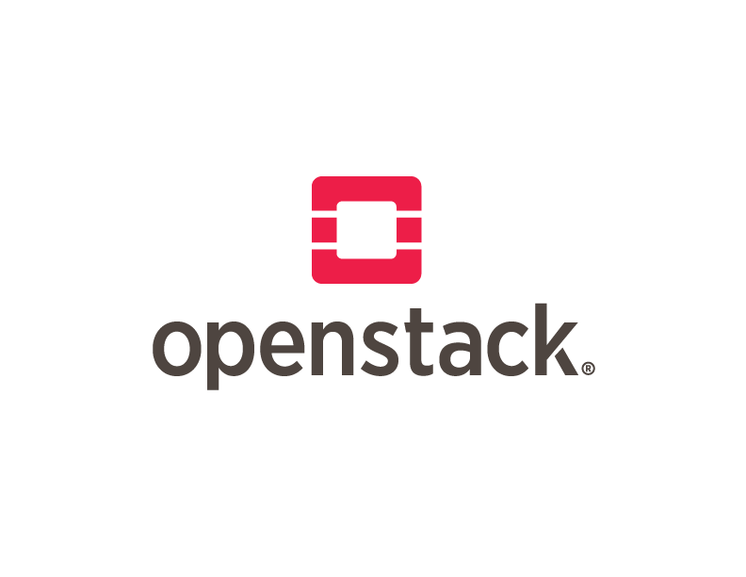





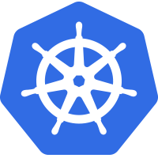
How did get here?
Cloud native computing uses an open source software stack to:
segment applications into containers,
packaging each part into its own container
and dynamically orchestrating those containers to optimize resource utilization
Non- Virtualized
Hardware
Open Source
IaaS
Open Source
PaaS
Cloud Native
Virtualiza- tion
IaaS
PaaS
Containers
2000
2001
2006
2009
2010
2011
2013
2015
38

Slide 39
What Have We Learned?
Core Building Block:
Servers ➡ Virtual Machines ➡ Buildpacks ➡ Containers
Isolation Units
From heavier to lighter weight, in spin-up time and size
Immutability
From pets to cattle
Provider
From closed source, single vendor to open source, cross-vendor
39

Slide 40
Iaas, CaaS, PaaS
Feature | Infrastructure-as-a-Service (Vmware) | Container-as-a-Service (Kubernetes) | Platform-as-a-Service (PCF)
Scheduling | DRS | Scheduler | Diego
Management | vCenter | Controller | Diego (AI) & BOSH (VMs & Services)
Scheduling unit | Virtual Machine | Pods (one or more containers) | Garden containers
Orchestration | VRA / VRO | API Server | Diego & BOSH
Configuration Management | Chef, Puppet, Ansible | Secrets, ConfigMaps, Lifecycle hooks, Init containers | BOSH (only for VMs)
Health Checks | vCenter, vmtools probes | Liveness and Readness Probes (HTTP/TCP/CMD) | BOSH Resurrector (only for VMs), BBS (for application containers)
Target Workloads | Virtual Machine | Virtual Machine, Monolith Applications, 12-factor micro-services | 12-factor micro services
Persistent Storage | VSAN, NFS, iSCSI | VSAN, NFS, iSCSI, RBD, cloud storage (AWS, Azure, GCP) | Volume Services under development
Platform support | Physical, Cloud | Physical, Virtual, and Cloud | Virtual and Cloud
Resources Management | CPU, Memory, Disk, Network | CPU, GPU, Memory, Network, Disk (Quotas) and fine grained container resource mgmt | Only Disk and Memory via quotas
Affinity & Anti-affinity | vCenter | Native Feature | NONE
Taints & Tolerations |  | Native Feature | NONE
40
Notes:
http://blog.kubernetes.io/2017/03/advanced-scheduling-in-kubernetes.html

Slide 41
Iaas, CaaS, PaaS
Feature | Infrastructure-as-a-Service (Vmware) | Container-as-a-Service (Kubernetes) | Platform-as-a-Service (PCF)
High Availability | Vmware HA Cluster | ReplicaSets, StatefulSets | Multiple AIs
Disaster Recovery | SRM | Self Hosting (Bootkube), Operators (TRPs) | NONE
Service Discovery | NONE | Service, DNS | Service Registry (one foundation)
Load Balancing | NSX (NFV), | Service (iptables, IPVS) | GO Router
Federation |  | Federation API | NONE
Self Healing | Vmware HA Cluster | Controller, Scheduler | BOSH Resurrector (only for VMs), BBS (for application containers)
Zero Downtime Upgrades | vMotion | Self Hosting (Bootkube) | Partial Support
Networking | Virtual Networking | Overlay, L2, Routed (L3) | NAT
Auto Scaling/Idling | VRA, VRO, VROPS | Pod Horizontal/Vertical Auto scaler (CPU, Memory, Custom Metrics). Cluster Auto Scaler. | AI (Container Auto Scaler – CPU only)
Network Security | NSX, Cisco ACI | Network Security Policy, Cisco ACI. All cluster components secured using TLS. Application TLS terminated at containers. | Foundation components are not secured. ASGs provide means to define egress policies. Application TLS terminated at “Go Routers”
41

Slide 42
TECHNICAL DEEP DIVE

Slide 43
MONITORING APPLICATION HEALTH

Slide 44
AUTO-HEALING FAILED PODS
RED HAT
ENTERPRISE LINUX
NODE
NODE
NODE
MASTER
API/AUTHENTICATION
c
DATA STORE
C
C
C
RHEL
RHEL
RHEL
SCHEDULER
NODE
NODE
NODE
HEALTH/SCALING
c
C
C
RHEL
RHEL
RHEL
Notes:
Speaker:
* The Master is responsible for monitoring the health of Pods, and for automatically scaling them as desired
* Users configure Pod probes for liveness and readiness
* Currently pods may be automatically scaled based on CPU utilization
Discussion:
* The Master handles checking the health of pods by executing the defined liveness and readiness probes
* Probes can be easily defined by users
* Autoscaling is available today against CPU only
* The next slides will depict a health event for you to describe
Transcript:
The OpenShift Master is capable of monitoring application health via user-defined Pod probes. The Master is also capable of scaling out Pods based on CPU utilization metrics.

Slide 45

AUTO-HEALING FAILED CONTAINERS
RED HAT
ENTERPRISE LINUX
NODE
NODE
NODE
MASTER
API/AUTHENTICATION
c
DATA STORE
C
C
C
RHEL
RHEL
RHEL
SCHEDULER
NODE
NODE
NODE
HEALTH/SCALING
c
C
C
RHEL
RHEL
RHEL
Notes:
Speaker:
* What happens when the Master sees that a Pod is failing its probes?
* What happens if containers inside the Pod exited because of a crash or other issue?
Discussion:
* Here you are describing the beginning of how the Master detects failures and remediates them
Transcript:
This first slide allows you to ask the question “What happens when…?”. The next slide will describe the remediation process for failed Pods.

Slide 46
AUTO-HEALING FAILED CONTAINERS
RED HAT
ENTERPRISE LINUX
NODE
NODE
NODE
MASTER
API/AUTHENTICATION
c
DATA STORE
C
C
C
RHEL
RHEL
RHEL
SCHEDULER
NODE
NODE
NODE
HEALTH/SCALING
c
C
C
RHEL
RHEL
RHEL
Notes:
Speaker:
* The Master will automatically restart Pods that have failed probes or possibly exited due to container crashes.
* Pods that fail too often are marked as bad and are temporarily not restarted.
* OpenShift’s service layer makes sure that it only sends traffic to healthy Pods, maintaining component availability -- all orchestrated by the Master automatically.
Discussion:
* The Master will restart Pods that are determined to be failing, for whatever reason.
* The Service layer is automatically updated with only healthy Pods as endpoints.
* All of this is done automatically.
* Pods that continually fail are not restarted for a while. This is a “crash loop back-off”.
Transcript:
The OpenShift Master is capable of remediating Pod failures automatically. It manages the traffic through the Service layer to ensure application availability and handles restarting Pods, all automatically and without any user intervention.

Slide 47

AUTO-HEALING FAILED CONTAINERS
RED HAT
ENTERPRISE LINUX
NODE
NODE
NODE
MASTER
API/AUTHENTICATION
c
DATA STORE
C
C
C
RHEL
RHEL
RHEL
SCHEDULER
NODE
NODE
NODE
HEALTH/SCALING
c
C
C
RHEL
RHEL
RHEL
Notes:
Speaker:
* When a node fails, master sees that the pod is failing its probes
* It is essential the same process as when a pod fails for other reasons

Slide 48
AUTO-HEALING FAILED CONTAINERS
RED HAT
ENTERPRISE LINUX
NODE
NODE
NODE
MASTER
API/AUTHENTICATION
c
c
DATA STORE
C
C
C
RHEL
RHEL
RHEL
SCHEDULER
NODE
NODE
HEALTH/SCALING
C
C
RHEL
RHEL
Notes:
* The Master will automatically restart Pods that had been scheduled on the failed node, on other healthy nodes that have enough capacity
* OpenShift’s service layer makes sure that it only sends traffic to healthy Pods, maintaining component availability -- all orchestrated by the Master automatically.

Slide 49
NETWORKING

Slide 50
BUILT-IN SERVICE DISCOVERY INTERNAL LOAD-BALANCING
SERVICE
Name: payroll-frontend
IP: 172.10.1.23
Port: 8080
app=payroll
role=frontend
POD
POD
POD
app=payroll
app=payroll
role=frontend
role=frontend
app=payroll
version=1.0
version=1.0
role=backend
Notes:
A service is a grouping of pods that are running on the cluster based on a set of labels (selector). Services provide important features that are standardized across the cluster: internal load-balancing, service discovery between applications, and features to support zero-downtime application deployments.
Backing pods can be added to or removed from a service arbitrarily while the service remains consistently available, enabling anything that depends on the service to refer to it at a consistent address.
Services are assigned an IP address and port pair that, when accessed, proxy to an appropriate backing pod. External IPs can also be assigned to services in order to make them accessible from the outside network.
On the slide, the service is configured to discover pods and load-balance traffic between pods that have both app=payroll and role=frontend labels set
OpenShift has a built-in DNS so that the services can be reached by the service DNS as well as the service IP/port. In this example, service can be reach by the DNS name “payroll-frontend” without specifying the IP. This simplifies service discovery for applications since the service name tends to be constant across environments (dev, test, prod, etc) during the service lifecycle.
In order to reach a service by name across namespaces, one can use <service>.<pod_namespace>.svc.cluster.local

Slide 51
BUILT-IN SERVICE DISCOVERY INTERNAL LOAD-BALANCING
SERVICE
Name: payroll-frontend
IP: 172.10.1.23
Port: 8080
app=payroll
role=frontend
POD
POD
POD
POD
app=payroll
app=payroll
app=payroll
role=frontend
role=frontend
role=frontend
app=payroll
version=2.0
version=1.0
version=1.0
role=backend
Notes:
When a new pod is deployed on the cluster with the same labels as the service selector, it is automatically added to the list of endpoints load-balanced by the service. If one of the pod gets removed, the service immediately removes it from the list of endpoints and does not send traffic to it anymore.
Service selector allows load-balancing between multiple versions of the application pods (version=1.0 and version=2.0) in order to achieve A/B testing and other deployment patterns out-of-the-box
On the slide, the service is configured to discover pods and load-balance traffic between pods that have both app=payroll and role=frontend labels set. Since both v1 and v2 of the frontend pods are deployed and have those labels set, ⅓ of the traffic would be to sent to the frontend v2 to achieve canary release or A/B testing for example.

Slide 52


ROUTE EXPOSES SERVICES EXTERNALLY
EXTERNAL TRAFFIC
ROUTER
SERVICE
INTERNAL TRAFFIC
POD
POD
POD
Notes:
A route exposes a service at a host name, like www.example.com, so that external clients can reach it by name.
DNS resolution for a host name is handled separately from routing. Admin may have configured a DNS wildcard entry that will resolve to the node that is running the OpenShift Container Platform router
Pods running on OpenShift, don’t need to go through the routing layer and can interact with each other directly through the services.
After the router discovers the Pod endpoints via the service, it sends the Pod traffic directly to those endpoints and bypasses the service layer

Slide 53


ROUTING AND EXTERNAL LOAD-BALANCING
Pluggable routing architecture
HAProxy Router
F5 Router
Multiple-routers with traffic sharding
Router supported protocols
HTTP/HTTPS
WebSockets
TLS with SNI
Non-standard ports via cloud load-balancers, external IP, and NodePort

Slide 54

ROUTE SPLIT TRAFFIC
Split Traffic Between Multiple Services For A/B Testing, Blue/Green and Canary Deployments
ROUTE
90% traffic
10% traffic
SERVICE A
SERVICE B
App A
App A
App B
App B

Slide 55
EXTERNAL TRAFFIC TO A SERVICE ON A RANDOM PORT WITH NODEPORT
NodePort binds a service to a unique port on all the nodes
Traffic received on any node redirects to a node with the running service
Ports in 30K-60K range which usually differs from the service
Firewall rules must allow traffic to all nodes on the specific port
CLIENT
connect 192.10.0.10:31421
192.10.0.11:31421
192.10.0.12:31421
SERVICE
INT IP: 172.1.0.20:90
POD 10.1.0.1:90
POD
10.1.0.2:90
POD
10.1.0.3:90
NODE 192.10.0.10
NODE 192.10.0.11
NODE 192.10.0.12
Notes:
NodePort allow exposing non-standard ports for a service on all nodes in the cluster
If the node receiving the traffic doesn't have the target service running, the traffic is redirected to a node which has the pod running
While it is easier to configure than external IPs and Ingress (prev slide), it is a wasteful use of scarce port resources and it requires more privileges.

Slide 56
EXTERNAL TRAFFIC TO A SERVICE ON ANY PORT WITH INGRESS
Access a service with an external IP on any TCP/UDP port, such as
Databases
Message Brokers
Automatic IP allocation from a predefined pool using Ingress IP Self-Service
IP failover pods provide high availability for the IP pool
CLIENT
connect 200.1.0.10:90
SERVICE
EXT IP: 200.1.0.10:90
INT IP: 172.1.0.20:90
POD 10.1.0.1:90
POD
10.1.0.2:90
POD
10.1.0.3:90
NODE 192.10.0.10
NODE 192.10.0.11
NODE 192.10.0.12
Notes:
External IP allows assigning an external IP to a service so that client outside of the OpenShift cluster can connect to services inside the Openshift cluster (e.g. database, JMS broker) on that port. This is particularly useful for services that are running on ports other than 80/433, otherwise router is a more suitable alternative. It is also useful when the client needs to know a specific IP for the service in order to open firewalls or while-list it in their own system.
Each external IP address is guaranteed to be assigned to a maximum of one service. This ensures that each service can simply expose its chosen ports regardless of the ports exposed by other services.
The external IP address itself is not managed by the underlying Kubernetes infrastructure and must be maintained and provided by a cluster administrator. Managing external IPs is not convenient since application users cannot create external IP addresses themselves, and must work with cluster administrators to allocate an address for their usage. There is also no protections in place to restrict the usage of a particular external address configured within the cluster.
Ingress IP self-service is a functionality within OpenShift to streamline the allocation of External IP’s for accessing to services in the cluster. Cluster administrators can designate a range of addresses using a CIDR notation which allows an application user to make a request against the cluster for an external IP address. When a service is configured with the type LoadBalancer, an External IP address will be automatically assigned from the designated range.
Ingress is supported for non-cloud clusters. For cloud (GCE, AWS, and OpenStack) clusters, cloud provider’s load balancer service can be used to automatically deploy a load balancer to target the service’s endpoints.
The IP failover pods are responsible for providing the external IP range (Virtual IPs) and would run on one or more of the nodes (more than one for high availability) in the cluster or they can just run on the HAProxy (router) nodes.
The OpenShift cluster administrator must ensure that the external IP address pool terminates at one or more nodes in the cluster.

Slide 57
CONTROL OUTGOING TRAFFIC
SOURCE IP WITH EGRESS ROUTER
POD
NODE IP1
EXTERNAL SERVICE
Whitelist: IP1
POD
EGRESS SERVICE INTERNAL-IP:8080
EGRESS
ROUTER POD IP1
POD
Notes:
Egress router runs a service that redirects (proxies) traffic to a specified remote server, using a private source IP address that is not used for anything else. The service allows pods to talk to servers that are setup to only allow access from whitelisted IP addresses. When deploying an egress router, an IP address from the physical network that the node itself is on is reserved by the cluster administrator to be used by the egress router.
Application pods access the external service using the egress service on the service internal IP address or service name. The egress service redirects the traffic to the egress routers which in turn send the traffic to the external service with the egress IP (reserved on the node it’s running on) as the source IP. The external service accepts the traffic since the source IP (egress router IPs) is whitelisted.

Slide 58
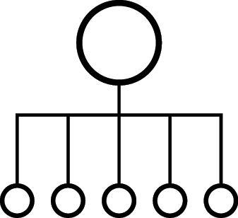

OPENSHIFT NETWORKING
Built-in internal DNS to reach services by name
Split DNS is supported via SkyDNS
Master answers DNS queries for internal services
Other nameservers serve the rest of the queries
Software Defined Networking (SDN) for a unified cluster network to enable pod-to-pod communication
OpenShift follows the Kubernetes Container Networking Interface (CNI) plug-in model
Notes:
OpenShift SDN can be configured to use Flannel instead of Open vSwitch. This is useful if running OpenShift Container Platform within a cloud provider platform that also relies on SDN, such as OpenStack, and you want to avoid encapsulating packets twice through both platforms.
OpenShift supports NuageSDN plugin up to and including the CNI plugin. NuageSDN itself is supported by Nuage.

Slide 59
OPENSHIFT NETWORK PLUGINS
OPENSHIFT
KUBERNETES CNI
OpenShift Plugin
Flannel
Plugin*
Nuage
Plugin
Essentials (Calico)
Plugin
Contrail (OpenContrail)
Plugin
Cisco
Contiv
Plugin
Big Switch
Plugin
VMware
NSX-T
Plugin
Open Daylight
Plugin
DEFAULT
Certified Plugin
Validated Plugin
In-Progress
* Flannel is minimally verified and is supported only and exactly as deployed in the OpenShift on OpenStack reference architecture
Notes:
For more details refer to OpenShift Third-Party SDN Statement of Support and FAQ [INTERNAL] https://pnt.redhat.com/pnt/p-7489293/OpenShift_Thi...-Oct-2017.pdf

Slide 60

OPENSHIFT NETWORKING
NODE 172.16.1.10
NODE 172.16.1.20
POD 10.1.2.1
POD 10.1.4.1
VxLAN Overlay Network
POD 10.1.2.2
POD 10.1.4.2
IP Network
Notes:
Pods are connected via an overlay network which enables IP-per-Pod networking and direct pod-to-pod communication
The Pod IPs are independent of the physical network the OpenShift Nodes are connected to

Slide 61
OPENSHIFT SDN
FLAT NETWORK (Default)
All pods can communicate with each other across projects
MULTI-TENANT NETWORK
Project-level network isolation
Multicast support
Egress network policies
NETWORK POLICY (Tech Preview)
Granular policy-based isolation
PROJECT A
PROJECT B
PROJECT C
DEFAULT NAMESPACE
NODE
NODE
✓
POD
POD
POD
POD
POD
POD
POD
POD
Multi-Tenant Network
Notes:
When the multi-tenant plugin is enabled, a cluster administrator can define egress firewall policies to limit the external addresses that some or all pods can access from within the cluster, so that for example
A pod can only talk to internal hosts, and cannot initiate connections to the public Internet.
A pod can only talk to the public Internet, and cannot initiate connections to internal hosts (outside the cluster).
A pod cannot reach specified internal subnets/hosts that it should have no reason to contact.

Slide 62
OPENSHIFT SDN - NETWORK POLICY
PROJECT A
PROJECT B
Example Policies
Allow all traffic inside the project
Allow traffic from green to gray
Allow traffic to purple on 8080
8080
✓
POD
POD
5432
POD
POD
apiVersion: extensions/v1beta1
kind: NetworkPolicy
metadata:
name: allow-to-purple-on-8080
spec:
podSelector:
matchLabels:
color: purple
ingress:
- ports:
- protocol: tcp
port: 8080
✓
POD
POD
✓
✓
POD
POD
Notes:
The ovs-networkpolicy plug-in (currently in Tech Preview) allows project administrators to configure granular isolation policies using NetworkPolicy objects.
A network policy is a specification of how groups of pods (using labels) are allowed to communicate with each other and other network endpoints
By default, all projects are able to access pods in all other projects. The project to be isolated must first be configured to opt in to isolation by setting the proper annotation on its Namespace object, and then creating NetworkPolicy objects indicating the incoming connections to be allowed.

Slide 63
OPENSHIFT SDN - OVS PACKET FLOW
Container to Container on the Same Host
NODE
POD 1
veth0 10.1.15.2/24
br0 10.1.15.1/24
vxlan0
eth0
POD 2
192.168.0.100
veth1 10.1.15.3/24

Slide 64
OPENSHIFT SDN - OVS PACKET FLOW
Container to Container on the Different Hosts
NODE 1
POD 1
veth0 10.1.15.2/24
br0 10.1.15.1/24
vxlan0
eth0
192.168.0.100
NODE 2
POD 2
veth0 10.1.20.2/24
br0 10.1.20.1/24
vxlan0
eth0
192.168.0.200

Slide 65
OPENSHIFT SDN - OVS PACKET FLOW
Container Connects to External Host
Container to Container on Different Hosts
NODE 1
External Host
POD 1
veth0 10.1.15.2/24
br0 10.1.15.1/24
tun0
eth0
192.168.0.100

Slide 66
OPENSHIFT SDN WITH
FLANNEL FOR OPENSTACK
NODE 1
POD 1
veth0 10.1.15.2/24
docker0 10.1.15.1/24
Routing Table
eth0
192.168.0.100
flanneld
etcd
NODE 2
flanneld
POD 2
veth0 10.1.20.2/24
docker0 10.1.20.1/24
Routing Table
eth0
192.168.0.200
Flannel is minimally verified and is supported only and exactly as deployed in the OpenShift on OpenStack reference architecture https://access.redhat.com/articles/2743631
Notes:
As an alternative to the default SDN, OpenShift Container Platform also supports flannel-based networking when running within a cloud provider platform that also relies on SDN, such as OpenStack, and you want to avoid encapsulating packets twice through both platforms.
OpenShift Container Platform runs flannel in host-gw mode, which maps routes from container to container. Each host within the network runs an agent called flanneld, which is responsible for:
Managing a unique subnet on each host
Distributing IP addresses to each container on its host
Mapping routes from one container to another, even if on different hosts
Each flanneld agent provides this information to a centralized etcd store so other agents on hosts can route packets to other containers within the flannel network.

Slide 67
LOGGING & METRICS

Slide 68
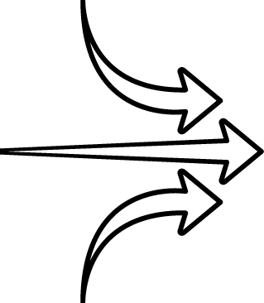


CENTRAL LOG MANAGEMENT WITH EFK
EFK stack to aggregate logs for hosts and applications
Elasticsearch: an object store to store all logs
Fluentd: gathers logs and sends to Elasticsearch.
Kibana: A web UI for Elasticsearch.
Access control
Cluster administrators can view all logs
Users can only view logs for their projects
Ability to send logs elsewhere
External elasticsearch, Splunk, etc

Slide 69
CENTRAL LOG MANAGEMENT WITH EFK
RHEL
NODE
POD
POD
OPERATION LOGS
RHEL
NODE
FLUENTD
ELASTIC
ELASTIC
POD
POD
ELASTIC
ELASTIC
ELASTICSEARCH
KIBANA
POD
POD
RHEL
ADMIN
NODE
FLUENTD
POD
POD
APPLICATION LOGS
POD
POD
ELASTIC
ELASTIC
ELASTIC
ELASTIC
FLUENTD
ELASTICSEARCH
KIBANA
POD
POD
USER
Notes:
Fluentd pulls logs from docker filesystem and openshift services on host, sends them to respective elasticsearch clusters. OpenShift can be configured to use the same elasticsearch cluster for both application and operation logs
Elasticsearch clusters store the aggregated log data
Users and platform admins access their respective kibana interfaces to see application aggregated logs or platform aggregated logs
OpenShift can be configured to send the logs to an external elasticsearch cluster

Slide 70
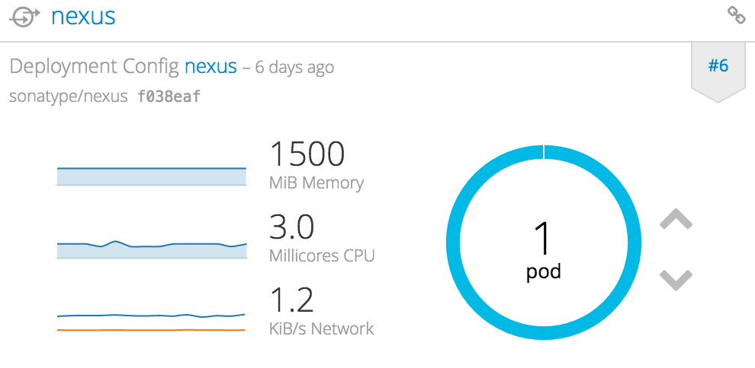
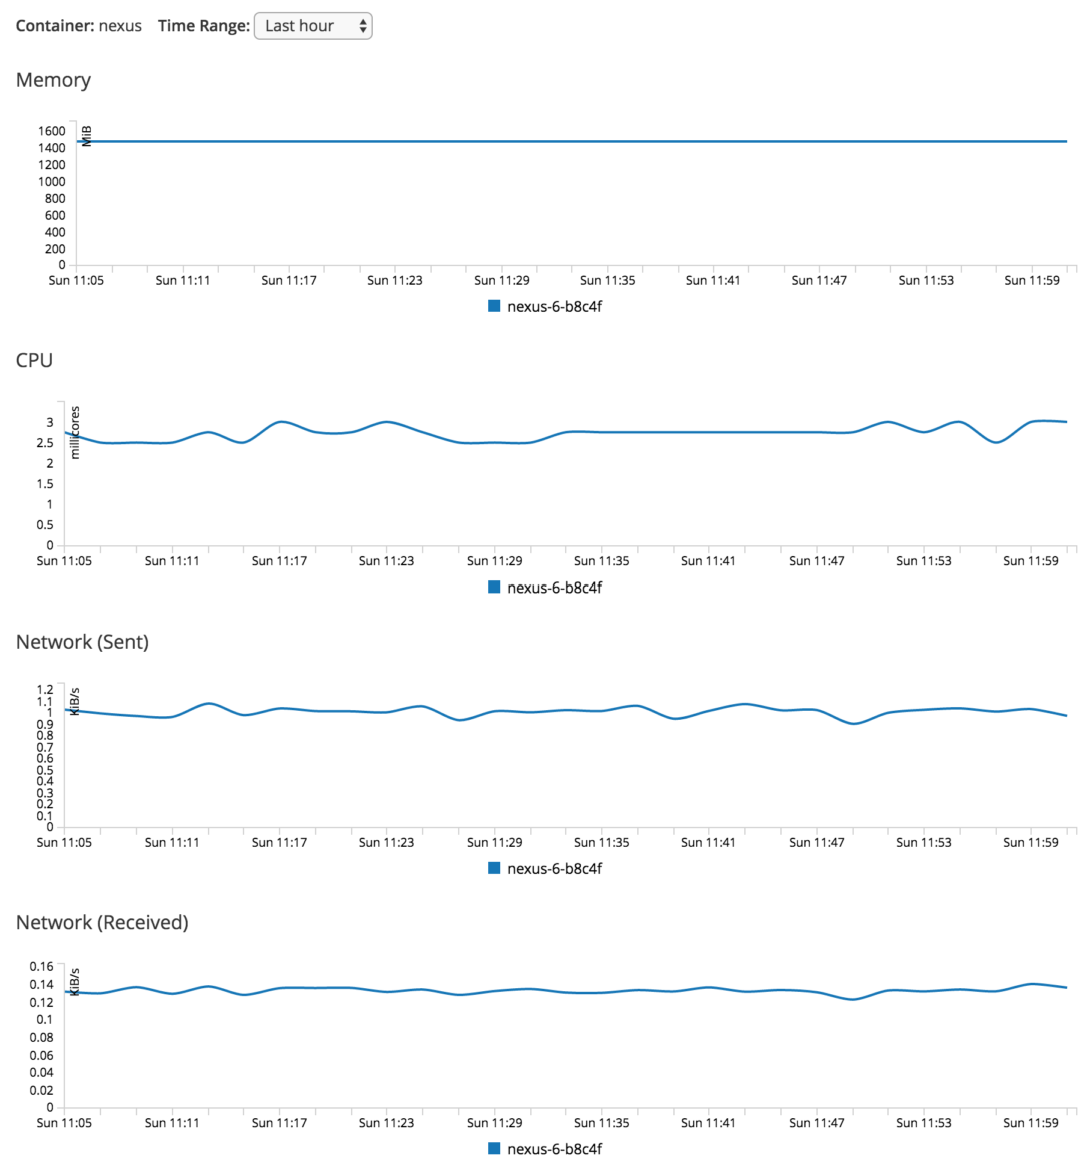
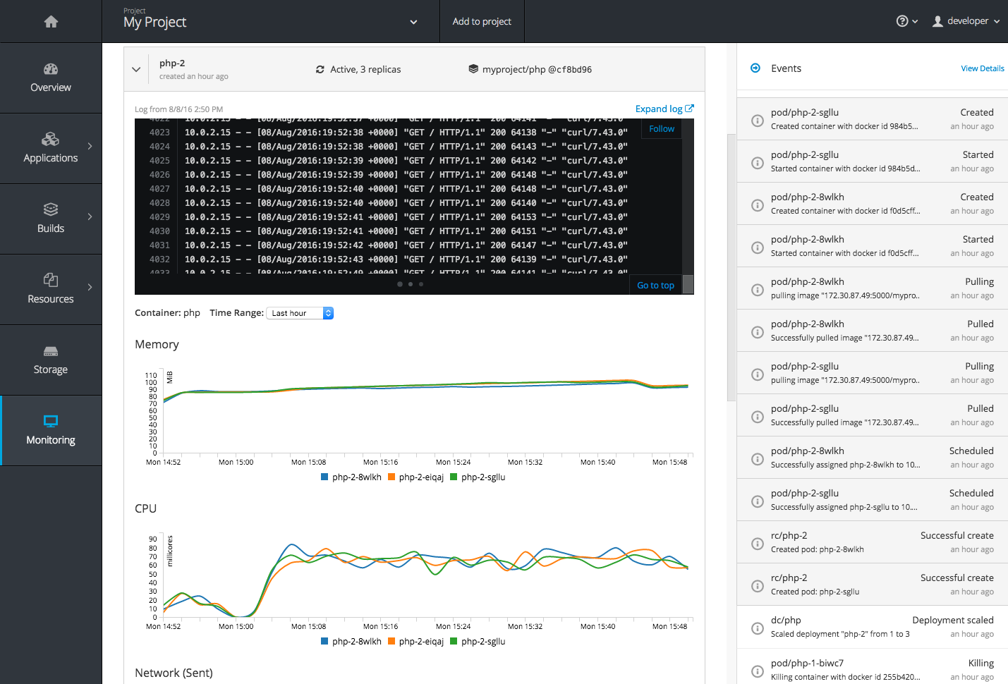
CONTAINER METRICS

Slide 71
CONTAINER METRICS
RHEL
NODE
POD
POD
CONTAINER METRICS
RED HAT
CLOUDFORMS
RHEL
NODE
FLUENTD
POD
POD
API
POD
POD
HEAPSTER
HAWKULAR
OPENSHIFT
WEB CONSOLE
RHEL
NODE
USER
FLUENTD
POD
POD
CUSTOM
DASHBOARDS
POD
POD
ELASTIC
ELASTIC
CASSANDRA
CADVISOR
POD
POD
Notes:
cadvisor on the node gathers cpu and memory information for pods and makes it available at the /stats endpoint
heapster interrogates every node to learn about the node as well as the pods running on it
heapster sends this information into Hawkular, which stores it in the cassandra database
The OCP console calls the Hawkular REST endpoint to make the data available to users in the console

Slide 72
SECURITY

Slide 73
TEN LAYERS OF CONTAINER SECURITY
Container Host & Multi-tenancy
Federated Clusters
Container Platform
API Management
Network Isolation
Deploying Container
Container Registry
Container Content
Storage
Building Containers

Slide 74



SECRET MANAGEMENT
Secure mechanism for holding sensitive data e.g.
Passwords and credentials
SSH Keys
Certificates
Secrets are made available as
Environment variables
Volume mounts
Interaction with external systems
Encrypted in transit
Never rest on the nodes
MASTER
Distributed Store
NODE
Container
Container
Notes:
Having an easy-to-use, secure-by-default secret distribution mechanism is exactly what developers and ops need to solve the secrets management problem once and for all
Because secret objects can be created independently of the pods that use them, there is less risk of the secret being exposed during the workflow of creating, viewing, and editing pods.
A secret is only sent to a node if a pod on that node requires it. It is not written to disk. It is stored in a temporary file-storage facilities (tmpfs). It is deleted once the pod that depends on it is deleted.
Secrets are stored as plaintext in etcd however the etcd storage can be encrypted to remove the security risk

Slide 75
PERSISTENT STORAGE

Slide 76
PERSISTENT STORAGE
Persistent Volume (PV) is tied to a piece of network storage
Provisioned by an administrator (static or dynamically)
Allows admins to describe storage and users to request storage
Assigned to pods based on the requested size, access mode, labels and type
NFS
OpenStack Cinder
iSCSI
Azure Disk
AWS EBS
FlexVolume
GlusterFS
Ceph RBD
Fiber Channel
Azure File
GCE Persistent Disk
VMWare vSphere VMDK
Notes:
OpenShift Container Platform leverages the Kubernetes persistent volume (PV) framework to allow administrators to provision persistent storage for a cluster. Using persistent volume claims (PVCs), developers can request PV resources without having specific knowledge of the underlying storage infrastructure.
OpenShift Container Platform supports a growing list of storage plugins for using various storage solutions.
Note that high-availability of storage in the infrastructure is left to the underlying storage provider.

Slide 77
PERSISTENT STORAGE
POOL OF PERSISTENT VOLUMES
register PV
iSCSI PV
Ceph RBD PV
NFSPV
NFSPV
NFSPV
GlusterFS
PV
Admin
PROJECT
Pod
Pod
Pod
create claim
User
claim
claim
claim
Notes:
Administrators define a pool of Persistent Volumes (PV) which are backed by network storage solutions like NFS, iSCSO, AWS EBS, etc and make them globally available in the OpenShift cluster.
Users within their projects can create a Persistent Volume Claim (PVC) in order to request a PV to be available within their pods. In the pod definition, a developer can refer to the PVC and mount the requested persistent volume inside the pod at an arbitrary path.
If a pod gets restarted, OpenShift mounts the same persistent volume into the pod again so that the pod data is available. PVs outlive the containers that were using them.

Slide 78
DYNAMIC VOLUME PROVISIONING
Slow Azure-Disk
Azure Provisioner
define StorageClass
Fast AWS-SSD
AWS Provisioner
Admin
Fastest NetApp-Flash
provision
NetApp Provisioner
PV
Pod
OpenShift
PV Controller
create claim: Fastest
bound
User
claim
Notes:
Dynamic provisioning allows provisioning persistent volumes on-demand when users request it rather than admins predefining them in advance
StorageClass is a blueprint of how to provision persistent volumes on a network storage. OpenShift provides a set of provisioners that determine what volume plugins should be used for provisioning the volumes. OpenShift also supports third-party plugins that are not part of Kubernetes, such as NetApp Trident
Admins creates a catalog of StorageClasses available in the OpenShift cluster. StorageClass names are arbitrary names to communicate their characteristics
Users can create a Persistent Volume Claim and specify the name of a StorageClass to instruct OpenShift on the type of persistent volume that should be provisioned for the them

Slide 79


CONTAINER-NATIVE STORAGE
Containerized Red Hat Gluster Storage
Native integration with OpenShift
Unified Orchestration using Kubernetes for applications and storage
Greater control & ease of use for developers
Lower TCO through convergence
Single vendor Support
APPLICATION
CONTAINER
APPLICATION CONTAINER
APPLICATION CONTAINER
DISTRIBUTED, SECURE, SCALE-OUT STORAGE CLUSTER
STORAGE
CONTAINER
STORAGE
CONTAINER
STORAGE
CONTAINER

Slide 80



CONTAINER-NATIVE STORAGE
MASTER
NODE
NODE
NODE
NODE
RHGS
RHGS
POD
POD
RHGS
POD
POD
POD
POD
POD
POD
POD
POD
POD
POD
POD
Notes:
The goal of container-native storage (CNS) is to provide a solution that runs Red Hat Gluster Storage software as containers inside OpenShift as Kubernetes pods. CNS enables OpenShift users to add reliable, safe, and shared persistent storage to their projects. It allows OpenShift administrators to deploy and manage their GlusterFS storage clusters quickly and easily. OpenShift administrators can easily create GlusterFS volumes using Heketi, a GlusterFS multicluster volume manager, and then register the volume availability with OpenShift by submitting a persistent volume claim (PVC). GlusterFS also supports dynamic provisioning of persistent volumes and removes the need for administrators to define and create PVs in OpenShift upfront and have them created on-demand instead when users request a PV.
OpenShift users can take advantage of these GlusterFS volumes by submitting an OpenShift PVC, which is then bound to an appropriate persistent volume. When users employ their claim, OpenShift invokes the GlusterFS volume plug-in that mounts the appropriate GlusterFS volume from the node running the pod to enable the container referenced in the claim to access the desired volume.
The solution supports collocating other OpenShift (Kubernetes) application pods on the same OpenShift nodes as the Red Hat Gluster Storage pods, in a “hyper-converged” configuration.
Red Hat Gluster Storage pods can be deployed on any OpenShift nodes within the cluster that have one or more block devices with many logical volumes defined which are used as the bricks for volumes provided by Red Hat Gluster Storage pods.

Slide 81
SERVICE BROKER
Notes:
Service Broker Deep-Dive by Andrew Block https://docs.google.com/presentation/d/1isf-ocLA4YrV0T5KXDdxH6hte-Du-g8JEDBLkOfmxhU/edit#slide=id.g1f60798c16_0_0

Slide 82
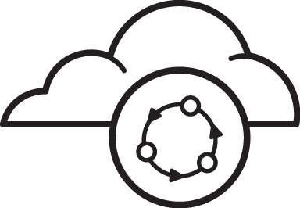
WHY A SERVICE BROKER?
☑ Open ticket
☑ Wait for allocation
☑ Receive credentials
☑ Add to app
☑ Deploy app
SERVICE CONSUMER
SERVICE
PROVIDER
Manual, Time-consuming and Inconsistent
Notes:
Service Consumer is a user or app that requests a service and uses it for example a user that needs an AWS RDS database for their application
Service Provider is the provider of the requested service for example AWS RDS
Majority of services are not managed by end users for example databases, message queues, etc
Users usually have to request services through the ticket system, wait for the allocation and after receiving the service coordinate, use that in their applications
In case of cloud services such as AWS, sometimes users are allowed to log in directly into the service provider admin console and provision the services themselves

Slide 83





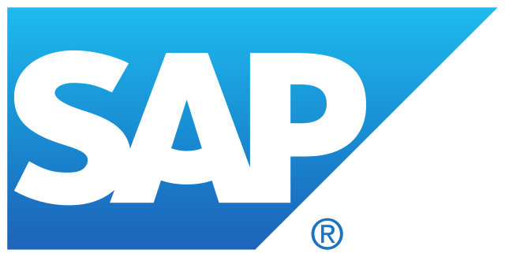
A multi-vendor project to standardize how services are consumed on cloud-native platforms across service providers

Slide 84

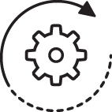
WHAT IS A SERVICE BROKER?
SERVICE CONSUMER
SERVICE
CATALOG
SERVICE
BROKER
SERVICE
PROVIDER
Automated, Standard and Consistent
Notes:
Service Catalog is where all services are published for consumption
Service Broker is responsible for managing and provisioning the service on the service provider and configure the credentials for the service consumer.
Each service provider would have a broker that knows how to provision services for that specific provider for example AWS would have a AWS Service Broker that knows how to create AWS services
Service providers might be running on or outside OpenShift and consequently, the service brokers might provision services on OpenShift or outside OpenShift. For example and OpenShift Ansible Broker, would use Ansible playbooks to provision a message queue running on OpenShift while the AWS service broker would provision an AWS RDS (database) instance on AWS.
OpenServiceBroker API defines the way service catalog and service broker works

Slide 85


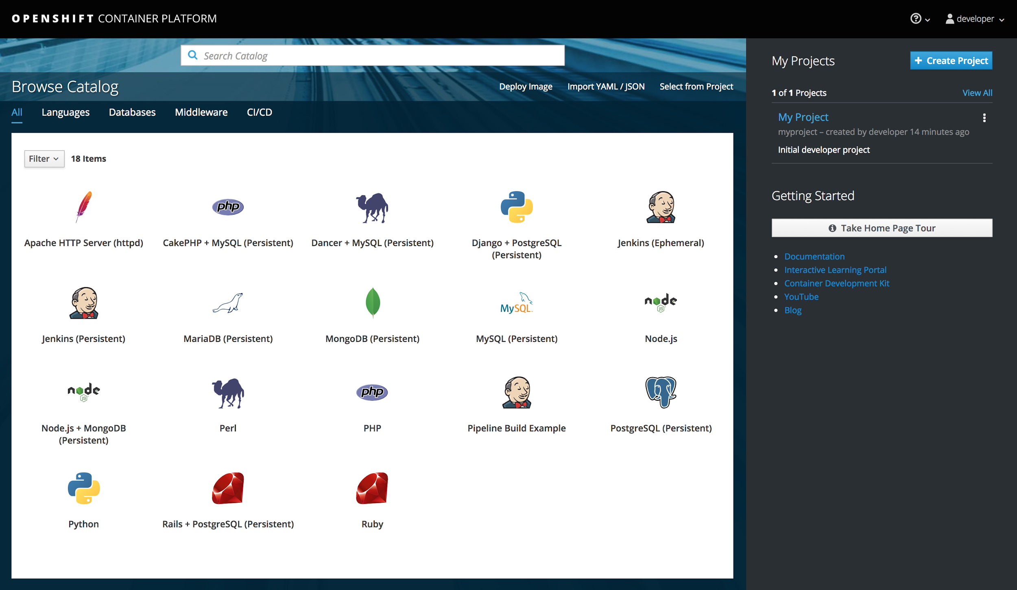
OPENSHIFT SERVICE CATALOG
OpenShift
Template
Broker
OPENSHIFT
OpenShift
Templates
OpenShift
Ansible
Broker
ANSIBLE
Ansible Playbook Bundles
AWS
Service
Broker
AWS
AWS Services
Other
Service
Brokers
OTHER COMPATIBLE SERVICES
Other
Services
OPENSHIFT SERVICE CATALOG
Notes:
Services from multiple service brokers can be published in the service catalog
OpenShift will be shipped with OpenShift Template Broker and OpenShift Ansible Brokers
OpenShift Template Broker is responsible for provisioning OpenShift templates on the cluster
OpenShift Ansible Broker allows leveraging existing investment in Ansible roles/playbooks and deploys a lightweight application definition called Ansible Playbooks Bundles (APB). APB uses named playbooks to provision, bind and unprovision services.
OpenShift Template Broker and OpenShift Ansible Broker will be by default included in OCP 3.6
Service Catalog is Tech Preview in OCP 3.6. Note that enabling the Service Catalog would render the entire OpenShift cluster as Tech Preview.
AWS Service Broker is available in OCP 3.7

Slide 86
SERVICE BROKER CONCEPTS
SERVICE: an offering that can be used by an app e.g. database
PLAN: a specific flavor of a service e.g. Gold Tier
SERVICE INSTANCE: an instance of the offering
PROVISION: creating a service instance
BIND: associate a service instance and its credentials to an app
SERVICE CONSUMER
SERVICE
CATALOG
SERVICE
BROKER
SERVICE
PROVIDER

Slide 87
HOW TO ADD A SERVICE BROKER
Deploy service broker on or off OpenShift
Register the broker referring to the deployed broker
Register the broker services by creating ServiceClass resources (the service broker might automatically perform this step)
apiVersion: servicecatalog.k8s.io/v1alpha1
kind: Broker
metadata:
name: asb-broker
spec:
url: https://asb-1338-ansible-service-broker.10.2.2.15.nip.io

Slide 88
TEMPLATE SERVICE BROKER
Exposes Templates and Instant Apps in the Service Catalog
Pulled from openshift namespace by default
Multiple namespaces can be configured for template discovery

Slide 89
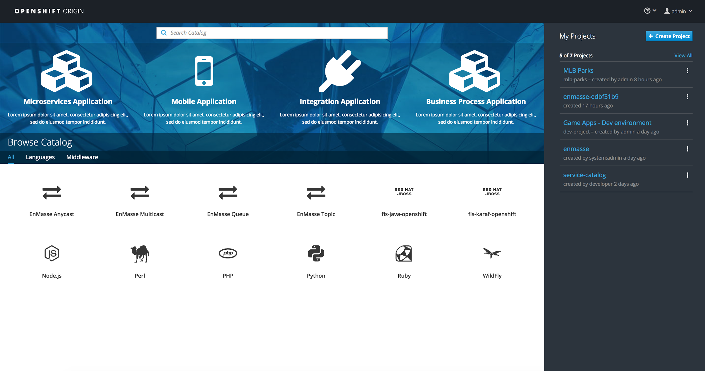
TEMPLATE SERVER BROKER PROVISIONING
Service Broker creates a the objects from the template
openshift namespace
nodejs-template
OpenShift Service Catalog
Template Service Broker
Node.js Container
Notes:
Exposes Templates and Instant Apps in the Service Catalog
Templates are pulled from openshift namespace by default
Multiple namespaces can be configured for template discovery

Slide 90
TEMPLATE SERVICE BROKER BINDING
Service Broker creates a binding and secret for any credentials (config map, secret, etc) created by the template
openshift namespace
nodejs-template
OpenShift Service Catalog
Template Service Broker
Node.js Container
create binding

Slide 91
OPENSHIFT ANSIBLE BROKER
Use Ansible on OpenShift
Deploy containerized applications
Provision external services (e.g. Oracle database)
Provision cloud services (e.g. AWS RDS)
Orchestrate multi-service solutions
Conditional logic for control on deployments (e.g. database is initialized)
Leverage existing Ansible playbooks
Anything you can do with Ansible, you can do with OAB

Slide 92
ANSIBLE PLAYBOOK BUNDLES (APB)
Lightweight application definition
Packaged as a container image
Embedded Ansible runtime
Metadata for parameters
Named playbooks for actions
Leverage existing Ansible playbooks
Registry is queried to discover APBs
Ansible Playbook Bundle (Container Image)
├─ roles
├─ playbooks
│ ├─ provision.yaml
│ ├─ unprovision.yaml
│ ├─ bind.yaml
│ └─ unbind.yaml
└─ apb.yaml
Ansible Runtime

Slide 93

OPENSHIFT ANSIBLE BROKER
PROVISIONING
Red Hat Container Catalog
Docker Hub
OpenShift Registry
mediawiki-apb
Discover and list APBs from the configured image registries
postgresql-apb
OpenShift Service Catalog
OpenShift Ansible Broker

Slide 94
OPENSHIFT ANSIBLE BROKER
PROVISIONING
Pull APB image and run it with the broker action as a parameter
Red Hat Container Catalog
Docker Hub
OpenShift Registry
mediawiki-apb
postgresql-apb
OpenShift Service Catalog
APB Container
(postgresql)
OpenShift Ansible Broker
oc run postgresql-apb provision $vars

Slide 95
OPENSHIFT ANSIBLE BROKER
PROVISIONING
APB container runs
provision.yaml playbook to create a PostgreSQL container
Red Hat Container Catalog
Red Hat Container Catalog
Docker Hub
OpenShift Registry
Docker Hub
OpenShift Registry
mediawiki-apb
mediawiki-apb
postgresql-apb
postgresql-apb
OpenShift Service Catalog
OpenShift Service Catalog
APB Container
(postgresql)
Postgre SQL Container
Postgre SQL Container
Ansible Service Broker
OpenShift Ansible Broker
oc run postgresql-apb provision $vars
ansible-playbook provision.yaml $vars

Slide 96
OPENSHIFT ANSIBLE BROKER
BINDING
APB container runs
bind.yaml playbook to create database user
Red Hat Container Catalog
Docker Hub
OpenShift Registry
mediawiki-apb
postgresql-apb
OpenShift Service Catalog
APB Container
(postgresql)
Postgre SQL Container
OpenShift Ansible Broker
oc run postgresql-apb bind $vars
ansible-playbook bind.yaml $vars
MediaWiki Container

Slide 97
OPENSHIFT ANSIBLE BROKER
BINDING
Red Hat Container Catalog
APB container goes away and Service Broker creates a binding for the PostgreSQL service
Docker Hub
OpenShift Registry
mediawiki-apb
postgresql-apb
OpenShift Service Catalog
Postgre SQL Container
OpenShift Ansible Broker
MediaWiki Container
create binding

Slide 98
OPENSHIFT ANSIBLE BROKER
BINDING
Red Hat Container Catalog
Service Catalog creates a secret for the binding, containing the database credentials
Docker Hub
OpenShift Registry
mediawiki-apb
postgresql-apb
OpenShift Service Catalog
Postgre SQL Container
OpenShift Ansible Broker
MediaWiki Container
mount binding secret

Slide 99
OPENSHIFT ANSIBLE BROKER
BINDING
Red Hat Container Catalog
MediaWiki container uses the credentials in the secret to connect to the PostgreSQL database
Docker Hub
OpenShift Registry
mediawiki-apb
postgresql-apb
OpenShift Service Catalog
Postgre SQL Container
OpenShift Ansible Broker
MediaWiki Container
mount binding secret

Slide 100
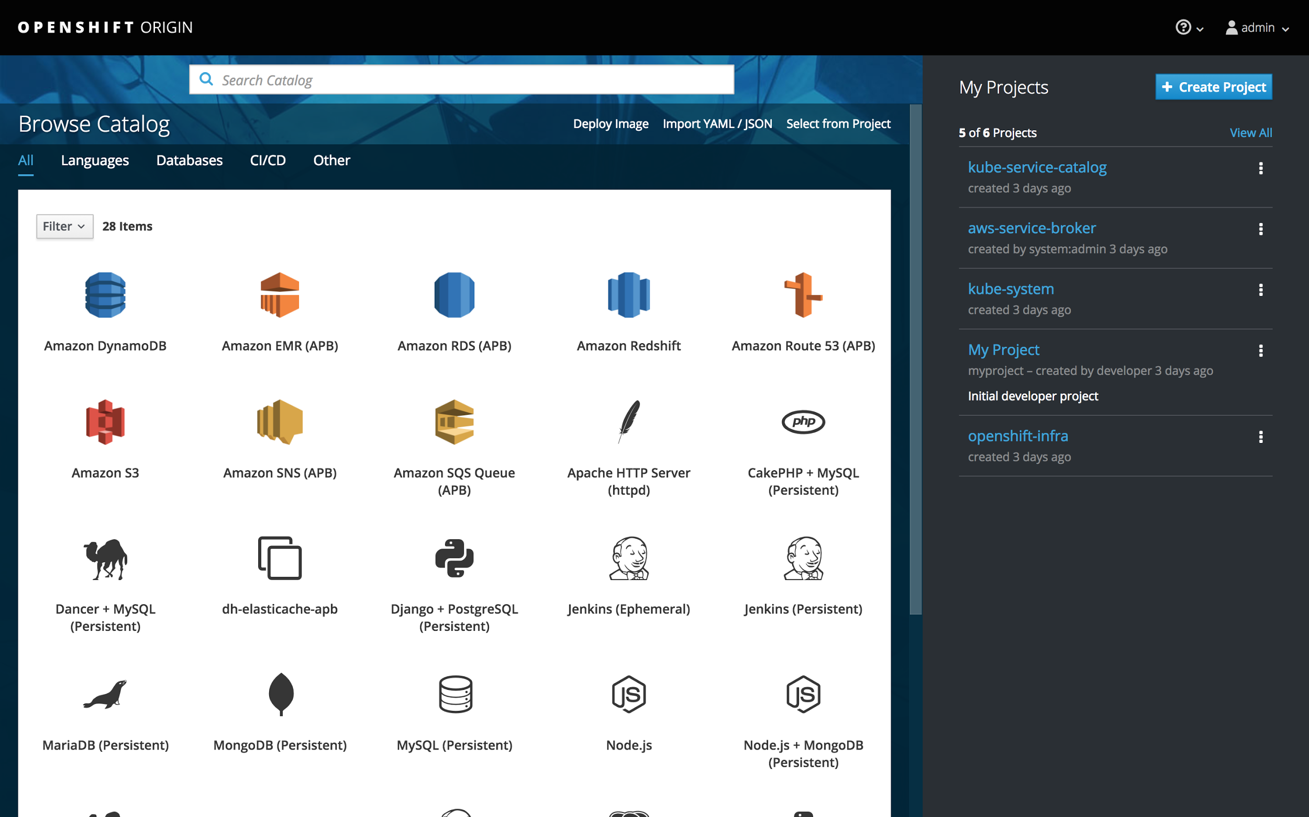
AWS SERVICE BROKER
Targets Top 10 AWS Services
Uses Ansible Playbook Bundles
Available in OpenShift 3.7
SQS
SNS
DynamoDB
Redshift SES
S3
RDS
EMR
AWS Batch
ElastiCache
Route 53

Slide 101
AWS PROVISIONING
APB container runs
provision.yaml playbook to interact with CFN and create RDS instance
AWS ECR
Compatible Docker Registries
s3-apb
rds-apb
OpenShift Service Catalog
APB Container
(rds)
AWS Cloud Formation
AWS
RDS
OpenShift Ansible Broker
oc run rds-apb provision $vars
ansible-playbook provision.yaml $vars

Slide 102
OPERATIONAL MANAGEMENT

Slide 103




TOP CHALLENGES OF
RUNNING CONTAINERS AT SCALE
OPERATIONAL
EFFICIENCY
SERVICE HEALTH
SECURITY
& COMPLIANCE
FINANCIAL
MANAGEMENT

Slide 104

Operational Management
Across the Stack
Real-time discovery
Visualize relationships
Monitoring and alerts
Vulnerability scanning
Security compliance
Workflow and policy
Automation
Chargeback
Notes:
Red Hat CloudForms is included in OpenShift Container Platform subscriptions for managing OpenShift clusters.

Slide 105
OPERATIONAL EFFICIENCY
CloudForms continuously discovers your infrastructure in near real time.
CloudForms discovers and visualizes relationships between infra components
CloudForms cross references inventory across technologies.
CloudForms offers custom automation via control policy or UI extensions
Notes:
CloudForms helps IT Ops to efficiently manage the container infrastructure by answering commons questions like
How many nodes do I actually have across all my deployments?
Where are my containers deployed and how are they connected to hosts, storage and other infrastucture components?
How can I troubleshoot issues across the infrastructure stack?
How can I automate common tasks?
With CloudForms, you have complete operational visibility and control over the entire lifecycle of the virtual instances that are deployed. You can see the resources that each virtual instance is consuming, so you can determine current and future capacity demands. You also can optimize your resources and track problems down to the root cause. In all, CloudForms helps you see and manage all of your virtual instances so that you can deliver the best experience to your users now, and in the future.
CloudForms continuously monitors systems in the environment in order to track resource utilization. Thanks to its continuous discovery capability, this applies to existing systems in the environment as well as new instances added to the environment. It can use this historical information to help see trends and project future resource usage. CloudForms can also help optimize environments, suggesting to right-size instances so that resources are utilized most efficiently.
CloudForms also discovers inventory and relationships, and one way it displays those is via our topology view. Here you can see a topology that shows OpenShift nodes and pods. But, interestingly, it also shows a Virtual Machine that is running the node. Note that this information comes from a different source. CloudForms learned about the nodes and pods via the OpenShift Kubernetes API, but got the information about the VM via the virtualization or cloud API. It then cross-linked the information together.

Slide 106
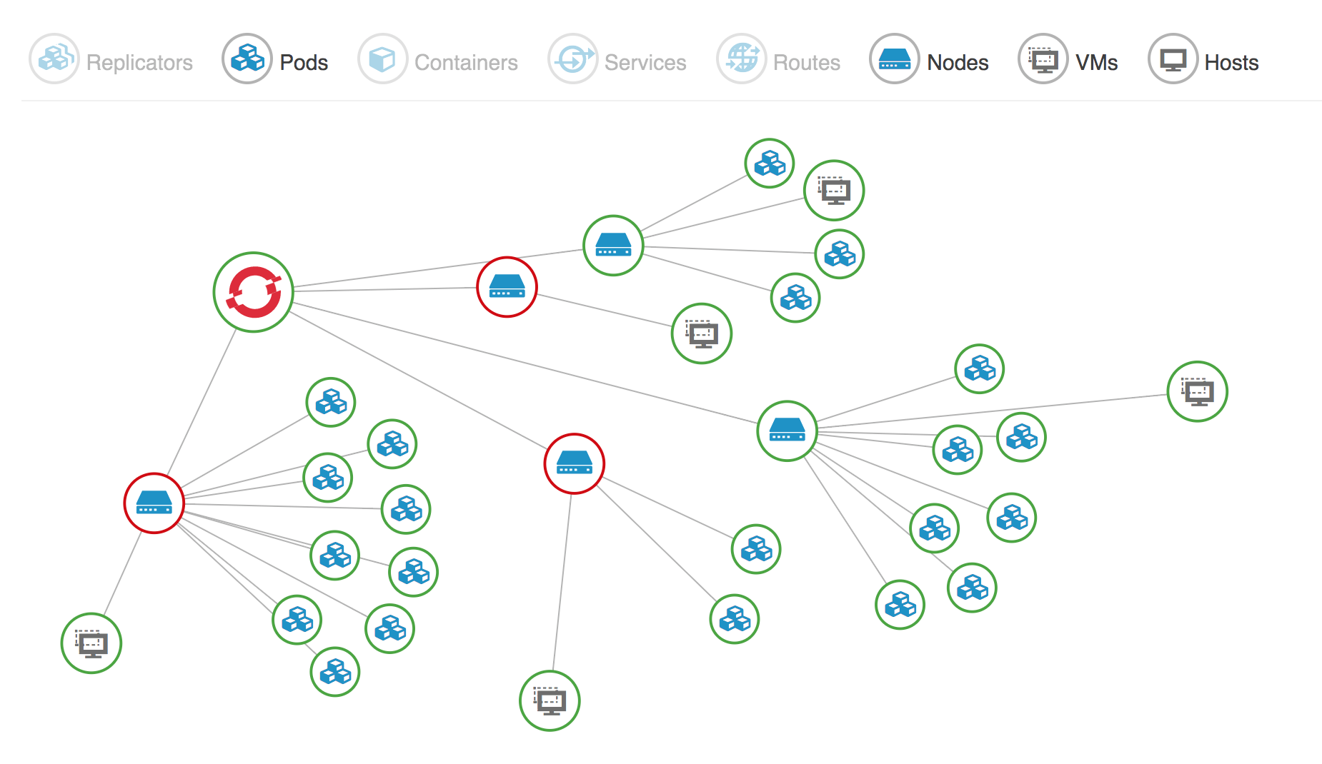
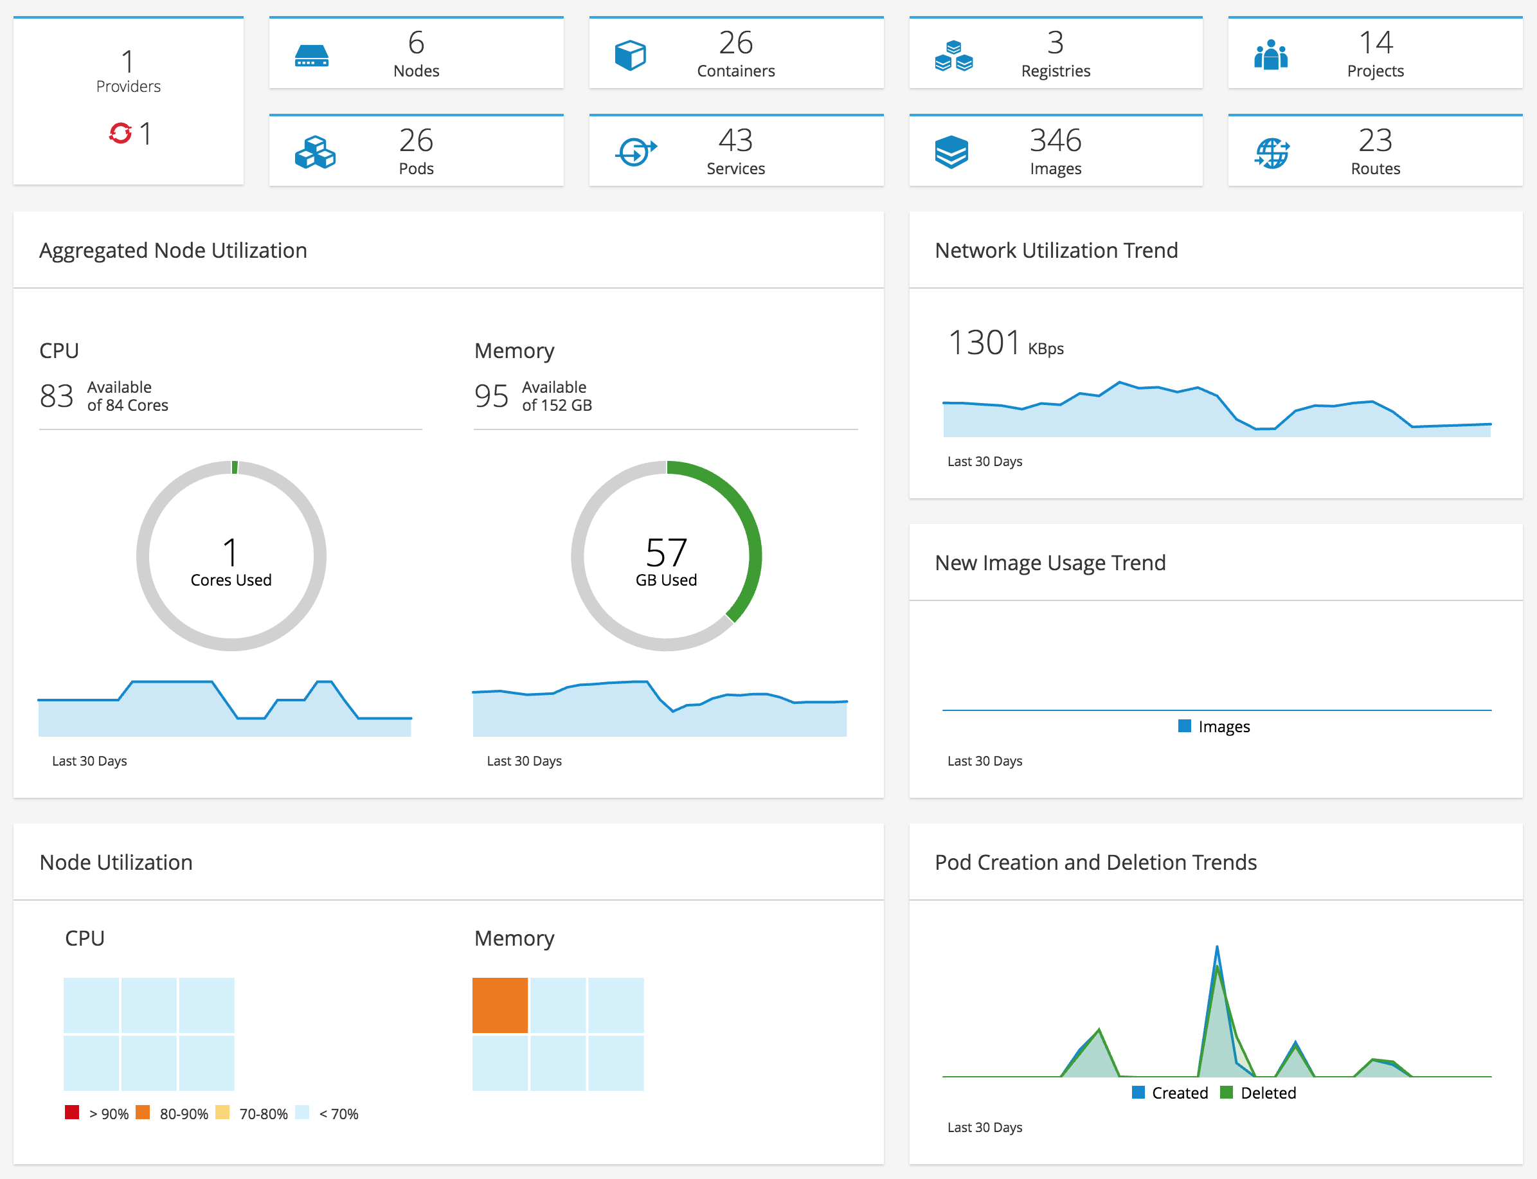
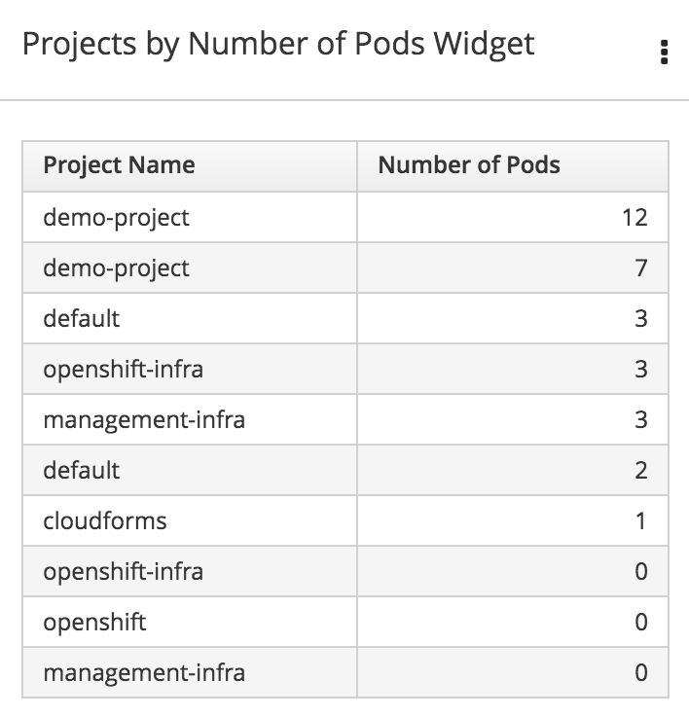
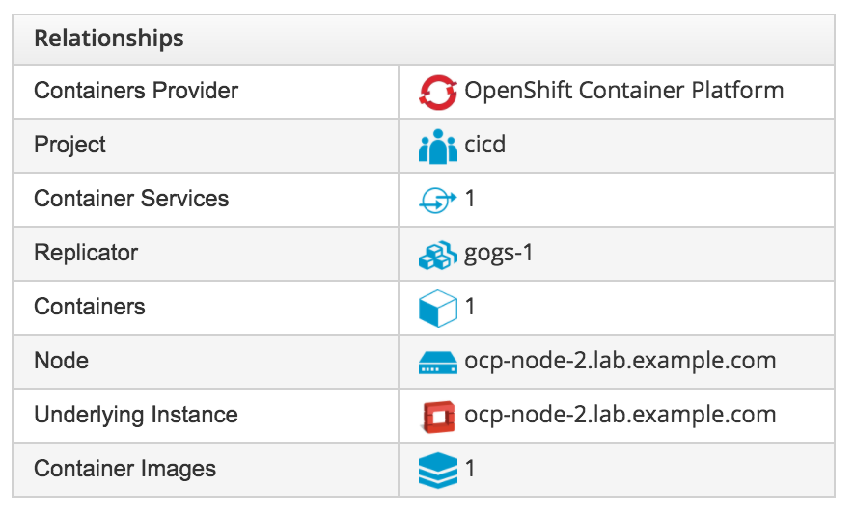
OPERATIONAL EFFICIENCY

Slide 107
SERVICE HEALTH
CloudForms monitors resource consumption and shows trends
CloudForms alerts on performance thresholds or other events
CloudForms offers right-sizing recommendations
CloudForms enforces configuration and tracks it over time.
Notes:
A second area of concern identified by our customers is service health. They need to be able to answer question like
Do I have enough spare capacity? When will I run out?
How I can get notified of issues?
Are my resources sized correctly?
Are my configurations correct and not drifting?
Our customers need to operate a well managed container service with good performance, reliability and high enough utilization ratios. But container environments have unique challenges here. For example, container environments are dynamic and can grow quickly. Therefore it is very important to keep an eye on your capacity and get notified when you run out, so that you can prevent unexpected service degradations. Another challenge is how to get notified of issues, be it performance or otherwise, at any layer in the stack. Also you want to make sure that your infrastructure is sized correctly, to prevent either performance issues, or over-provisioning leading to high costs. And finally, in order to guarantee a reliable service, you want to make sure that your configurations are correct and don’t change.
None of these issues are new or even unique to containers. But containers give a unique twist to them, and what we need is a single solution that can address these.
CloudForms can help customers improve and maintain the health of their container environment. It can monitor resource consumption at the different layers of the stack, between virtual machines, storage, networks and the containers themselves. CloudForms can also discover trends, and tell you when you need to add extra capacity. Secondly it can alert based on performance thresholds or other events, or based on combination of events at different layers in the stack. CloudForms offers right-sizing recommendations based on automatically determined normal operating ranges, to make sure that you have enough infrastructure to cover your current needs and projected growth, but not more. This allows high utilization ratios and an efficient use of the infrastructure. And finally it can automatically detect configurations at all the layers of the stack. CloudForms can even discover file contents and other settings, without the use of an agent. This configuration data can be compared to a master image or tracked over time, and CloudForms can alert if settings are changed. Ensuring proper configuration over time helps a lot in delivering a robust and reliable service.

Slide 108
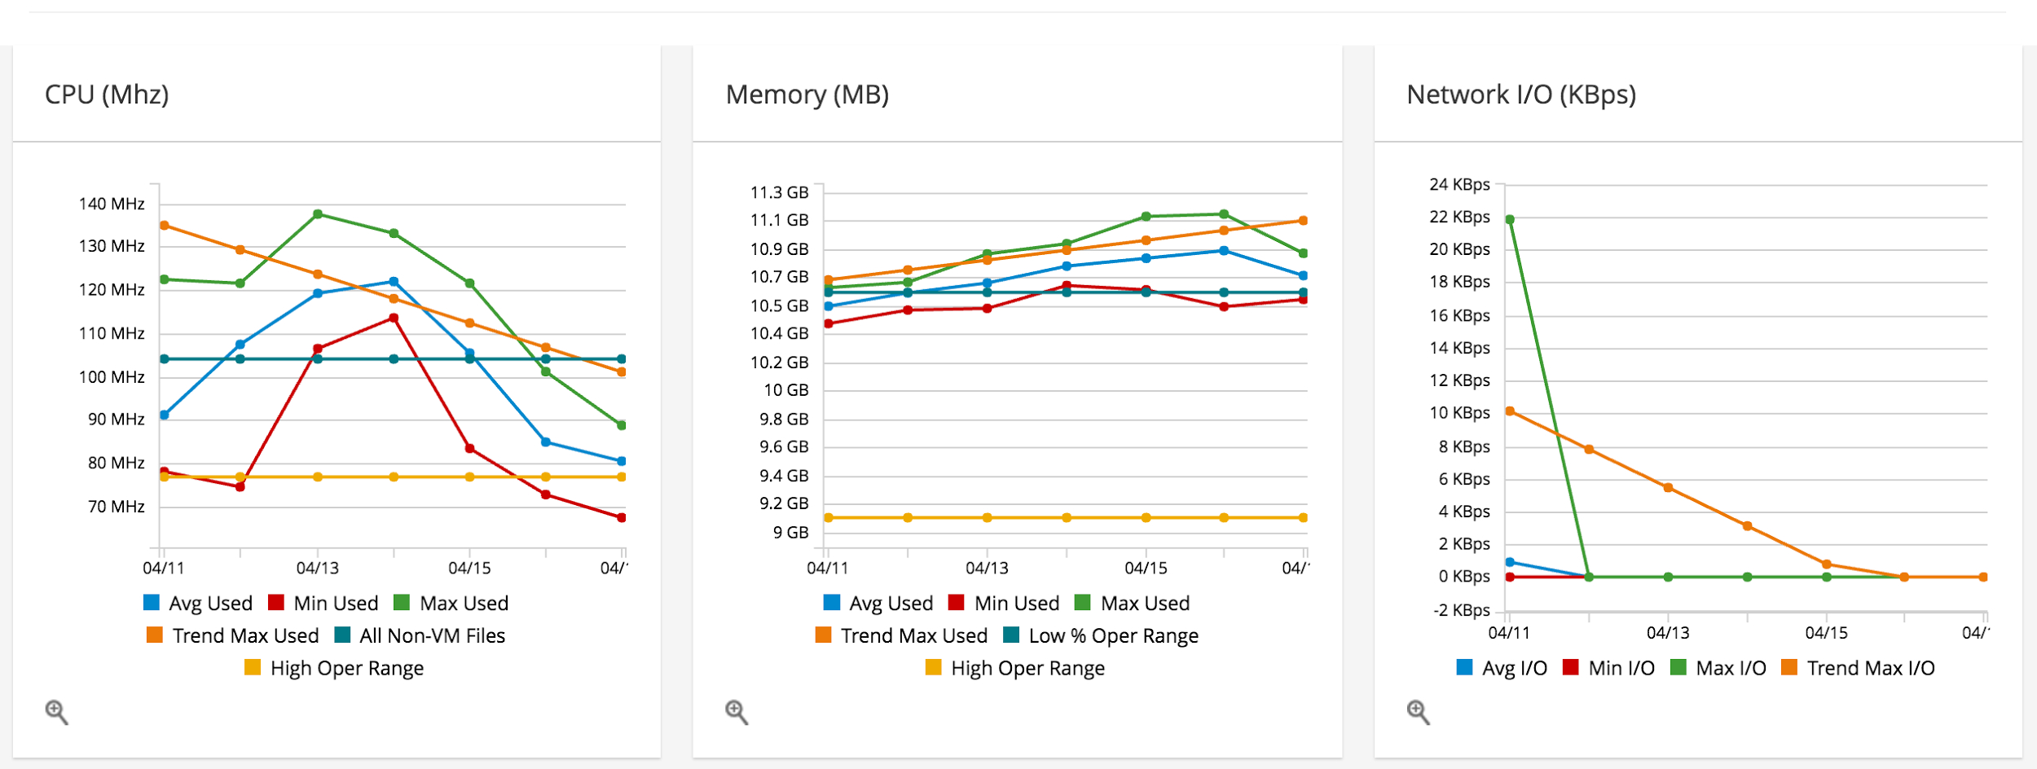
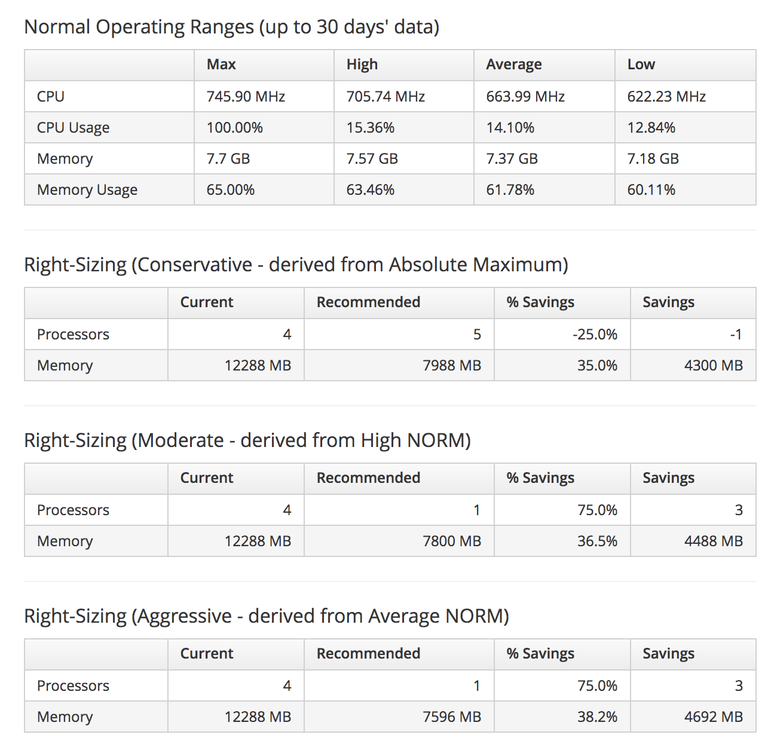
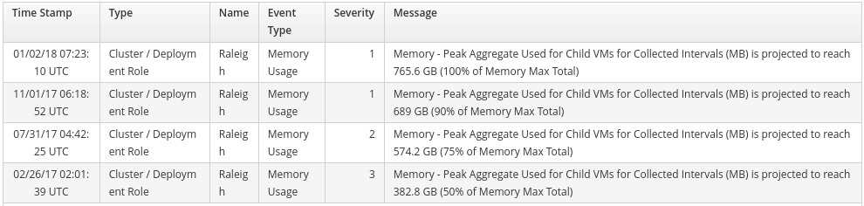
SERVICE HEALTH

Slide 109
SECURITY & COMPLIANCE
CloudForms finds and marks nodes non-compliant with policy.
CloudForms allows reporting on container provenance.
CloudForms scans container images using OpenSCAP.
CloudForms tracks genealogy between images and containers.
Notes:
One of the challenges of running containers in production is ensuring security and compliance. In a container based infrastructure, the software you run is often built directly by developers, usually via continuous integration. So once it comes to deploying these in production, it is very important to have a way to validate these containers and make sure they follow your security and compliance policies. Another challenge is the source of those containers. Developers could base their builds off any base image they can find on the Internet. But for enterprise IT it is important that they only build based on trusted sources that have been approved.
Customers need to answer questions like
Do my nodes and containers comply with my enterprise policy?
Are my developers using untrusted registries?
Are all my images patched properly?
Do I have containers running from unpatched images?
CloudForms has specific capabilities for managing security and compliance for container based infrastructures. It can enforce policies for container hosts, and mark nodes that are not compliant. Policies can take into account information about the container host itself, as well as any resources that are connected. If needed, it can trigger an action to start automatic remediation. CloudForms also provides reporting for container provenance. It can identify containers that come from, or are based on images from untrusted registries. Finally it can scan the contents of container images using OpenSCAP, which is an open framework for standardized security checks. When an image is identified as non-compliant, all running containers instantiated from this image can be flagged automatically.

Slide 110
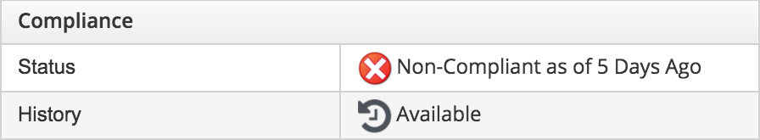
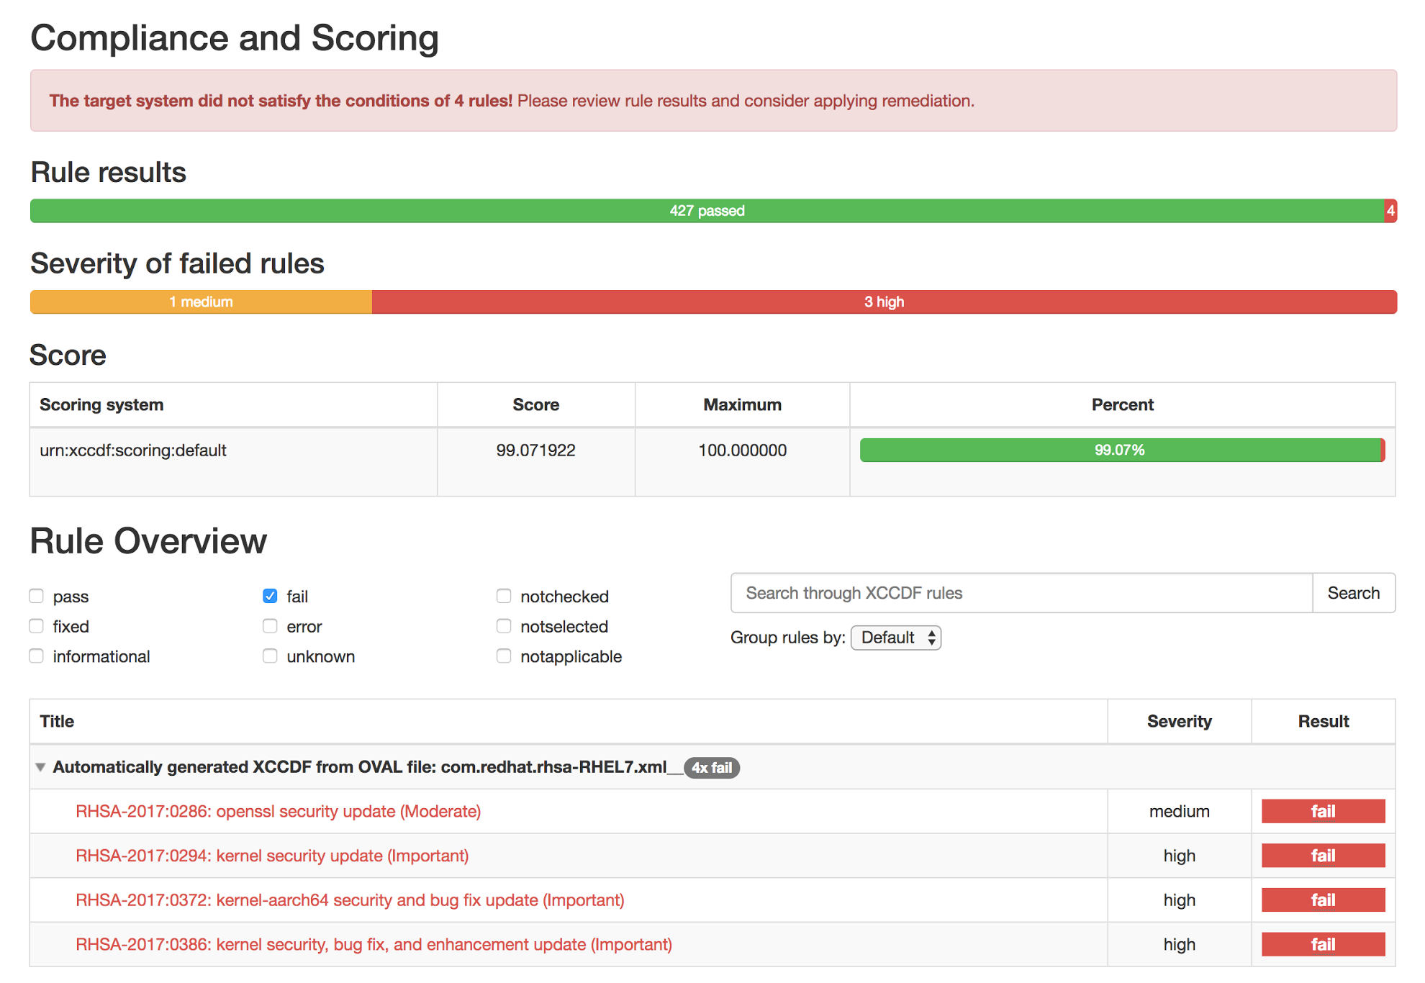
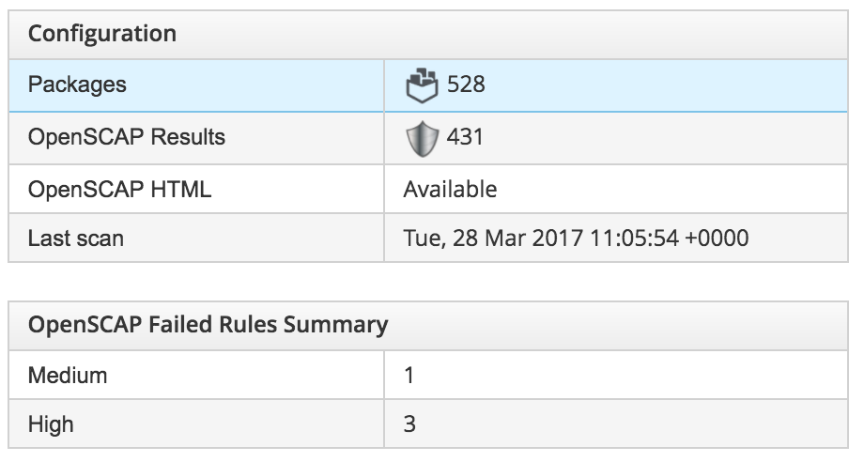
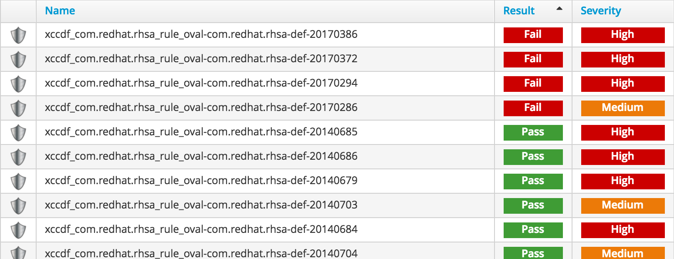
SECURITY & COMPLIANCE

Slide 111
FINANCIAL MANAGEMENT
Define cost models for infrastructure and understand your cost.
Rate schedules per platform and per tenant with multi-tiered and multi-currency support
CloudForms shows top users for CPU, memory, as well as cost.
Chargeback/showback to projects based on container utilization.
Notes:
Given that container workloads are highly dynamic, and that developers can deploy new ones very quickly, it’s important to know who is consuming what, and, if desired charge back those cost.
Customers need to answer questions like
How much does my container infrastructure cost me?
How do I see who is consuming most?
How can I pass through cost to my end users?
CloudForms allows you to define cost models at both the infrastructure and the container level. The infrastructure model gives you insight in the cost of operating the infrastructure, while the container model allows you to pass those cost on to the users. The chargeback models are very flexible. You can define and attach cost to CPU, memory, disk and network, both static, tiered and based on consumption. Multiple currencies are supported.

Slide 112
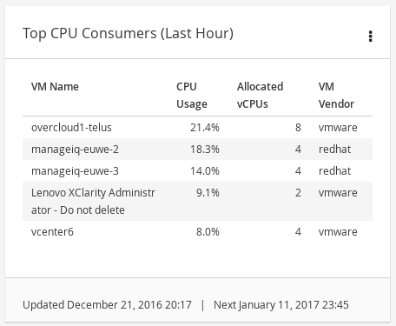
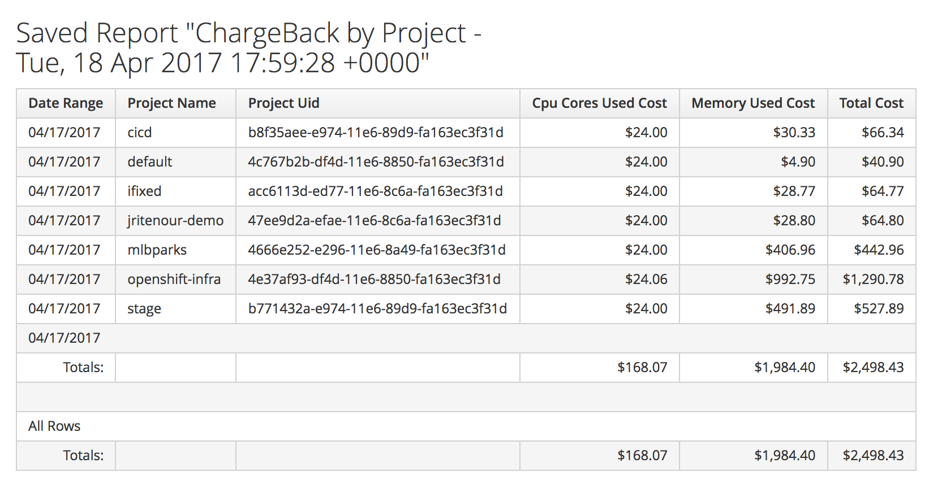
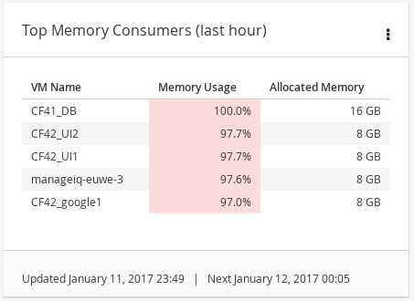
FINANCIAL MANAGEMENT

Slide 113
REFERENCE ARCHITECTURES

Slide 114
REFERENCE ARCHITECTURES
OpenShift on VMware vCenter
OpenShift on Red Hat OpenStack Platform
OpenShift on Amazon Web Services
OpenShift on Google Cloud Platform
OpenShift on Microsoft Azure
OpenShift on Red Hat Virtualization
OpenShift on HPE Servers with Ansible Tower
OpenShift on VMware vCenter 6 with Gluster
Deploying an OpenShift Distributed Architecture
OpenShift Architecture and Deployment Guide
OpenShift Scaling, Performance, and Capacity Planning
Application Release Strategies with OpenShift
Building Polyglot Microservices on OpenShift
Building JBoss EAP 6 Microservices on OpenShift
Building JBoss EAP 7 Microservices on OpenShift
Business Process Management with JBoss BPMS on OpenShift
Build and Deployment of Java Applications on OpenShift
Building Microservices on OpenShift with Fuse Integration...
JFrog Artifactory on OpenShift Container Platform
Spring Boot Microservices on Red Hat OpenShift
API Management with Red Hat 3scale on OpenShift
Notes:
On Red Hat Customer Portal: https://access.redhat.com/search/#/knowledgebase?q=&p=1&sort=lastModifiedDate%20desc&rows=10&srch=any&product=Red%20Hat%20OpenShift%20Container%20Platform&language=en&article_type=Reference%20Architecture&documentKind=Solution,Article

Slide 115
BUILD AND DEPLOY
CONTAINER IMAGES
Notes:
Builds and Pipelines Deep-Dive by Jorge Morales https://docs.google.com/presentation/d/1fwJ08L7jSaTSpDloVtRgzkBQwD7KFC5NBKB0SPpmxFo/edit#slide=id.p

Slide 116



BUILD AND DEPLOY CONTAINER IMAGES
DEPLOY YOUR
SOURCE CODE
DEPLOY YOUR
APP BINARY
DEPLOY YOUR
CONTAINER IMAGE

Slide 117







DEPLOY SOURCE CODE WITH SOURCE-TO-IMAGE (S2I)
BUILD APP
(OpenShift)
code
Git Repository
Developer
BUILD IMAGE
(OpenShift)
Source-to-Image (S2I)
Builder Image
Image Registry
DEPLOY
(OpenShift)
Application Container
deploy
User/Tool Does
OpenShift Does
Notes:
Blue: OpenShift does Green: User does
Developers write code using existing development tools such as Maven, NPM, Bower, PIP, Dockerfile and Git and then access the OpenShift Web, CLI or IDE to create an app from the code
S2I combines source code with a builder image (language and application runtimes) and stores the resulting application image in the image registry
This image registry by default is the OpenShift integrated docker registry however users can configure S2I to push the built images to third-party registries such as Docker Hub, Nexus, Artifactory, Amazon ECR, Quay, etc.
OpenShift monitors the builder images in the image registry and can automatically rebuild the application images if the language (e.g. Java, Ruby, etc) or application runtime (JBoss EAP, JBoss Web Server, Tomcat, etc) image is updated for example due to security patches.
OpenShift automates the deployment of application containers across multiple hosts via the Kubernetes. Users can trigger deployments, rollback, configure A/B or other custom deployments

Slide 118

DEPLOY APP BINARY WITH SOURCE-TO-IMAGE (S2I)
build
BUILD APP
(Build Infra)
Application Binary (e.g. WAR)
Existing Build Process
BUILD IMAGE
(OpenShift)
Source-to-Image (S2I)
Builder Image
Image Registry
DEPLOY
(OpenShift)
Application Container
deploy
User/Tool Does
OpenShift Does
Notes:
Blue: OpenShift does Green: User does
Developers use the existing build process and tools (e.g. Maven, Gradle, Jenkins, Nexus) to build the app binaries (e.g. JAR, WAR, EAR) and use OpenShift CLI to create an app from the app binaries
S2I combines app binaries (e.g. JAR, WAR, EAR) with a builder image (language and application runtimes) and stores the resulting application image in the image registry
This image registry by default is the OpenShift integrated docker registry however users can configure S2I to push the built images to third-party registries such as Docker Hub, Nexus, Artifactory, Amazon ECR, Quay, etc.
OpenShift monitors the builder images in the image registry and can automatically rebuild the application images if the language (e.g. Java, Ruby, etc) or application runtime (JBoss EAP, JBoss Web Server, Tomcat, etc) image is updated for example due to security patches.
OpenShift automates the deployment of application containers across multiple hosts via the Kubernetes. Users can trigger deployments, rollback, configure A/B or other custom deployments

Slide 119

DEPLOY DOCKER IMAGE
BUILD IMAGE
(Build Infra)
build
Application Image
Existing Image
Build Process
PUSH
(Build Infra)
Image Registry
DEPLOY
(Openshift)
deploy
Application Container
User/Tool Does
OpenShift Does
Notes:
Blue: OpenShift does Green: User does
App images are built using an existing image build process. OpenShift automates the deployment of app containers across multiple hosts via the Kubernetes. Users can trigger deployments, rollback, configure A/B, etc

Slide 120



BUILD IMAGES IN MULTIPLE STAGES
BUILD STAGE 1
BUILD STAGE 3
BUILD STAGE 2
Notes:
For compiled languages (Go, C, C++, Java, etc.), including the dependencies necessary for compilation in the application image might increase the size of the image or introduce vulnerabilities that can be exploited. To avoid these problems, two builds can be chained together: one that produces the compiled artifact, and a second build that places that artifact in a separate image that runs the artifact.
The first builds (stage 1 and stage 2) can use any of the build strategies on OpenShift such as Source-to-Image, Docker build, etc that will produce an image containing the desired artifacts
The second build (stage 3) can use any strategy that can consume input content from an image such as Docker build.

Slide 121
EXAMPLE: USE ANY RUNTIME IMAGE WITH SOURCE-TO-IMAGE BUILDS
Use Source-to-Image to build app binaries and deploy on lean vanilla runtimes
WILDFLY S2I BUILD
app.war
DOCKER BUILD
WildFly S2I
Builder Image
WildFly
Runtime Image
read more on https://blog.openshift.com/chaining-builds/
Notes:
An example for build chaining is when you want to use a vanilla image runtime like the official WildFly image to run your app in order to have a smaller footprint (not building build tools in the runtime), but still like to use the S2I feature to build your images )

Slide 122
EXAMPLE: USE ANY BUILD TOOL WITH OFFICIAL RUNTIME IMAGES
Use your choice of build tool like Gradle and deploy to official images like the JDK image
CUSTOM GRADLE BUILD
app.war
DOCKER BUILD
Custom
Gradle S2I
Builder Image
Red Hat
OpenJDK
Image
read more on https://blog.openshift.com/chaining-builds/
Notes:
Another example is when you want to use one of the officially supported image runtimes provided by OpenShift e.g. Java image, but you would like to use an alternative build tool rather than the one available in the image e.g. Gradle instead of Maven

Slide 123
EXAMPLE: SMALL LEAN RUNTIMES
Build the app binary and deploy on small scratch images
CUSTOM GO BUILD
app
DOCKER BUILD
Custom
Go S2I
Builder Image
Scratch Image
read more on https://blog.openshift.com/chaining-builds/
Notes:
Another example is when you want to use minimal scratch images to run your app in order to have a minimal attack surface and footprint. You can use a customer builder image like Go S2I build image and then copy the app binary to the scratch image using a Dockerfile

Slide 124
CONTINUOUS INTEGRATION (CI)
CONTINUOUS DELIVERY (CD)

Slide 125
CI/CD WITH BUILD AND DEPLOYMENTS
BUILDS
Webhook triggers: build the app image whenever the code changes
Image trigger: build the app image whenever the base language or app runtime changes
Build hooks: test the app image before pushing it to an image registry
DEPLOYMENTS
Deployment triggers: redeploy app containers whenever configuration changes or the image changes in the OpenShift integrated registry or upstream registries

Slide 126
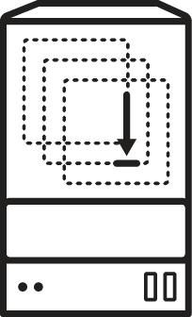
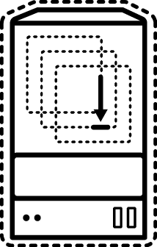
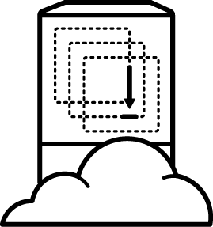
CONTINUOUS DELIVERY WITH CONTAINERS
physical
virtual
private cloud
dev
source repository
CI/CD engine
container
public cloud
Notes:
Continuous Integration (CI) means that the developer's working copies are synchronized with the share code repository several times a day. The code is built, integrated and unit tested every time a change is pushed to the shared code repository
Continuous Delivery (CD) is an extension of CI always be ready to deploy a product into production, but deploy to production requires manual approval
Continuous Deployment is the next step after gaining more confidence in the process, to automatically deploy the product into production whenever it passes QA.

Slide 127
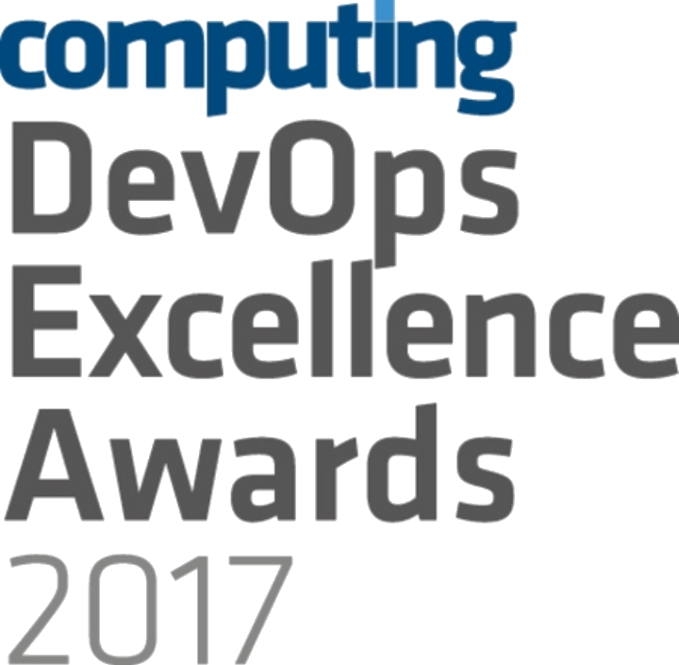



OPENSHIFT LOVES CI/CD
JENKINS-AS-A SERVICE
ON OPENSHIFT
HYBRID JENKINS INFRA WITH OPENSHIFT
EXISTING CI/CD DEPLOY TO OPENSHIFT
Notes:
OpenShift loves CI/CD and is in fact the winner of DevOps Excellence Awards 2017 in the Best Development Platform category http://events.computing.co.uk/devopsexcellence/static/2017-winners
OpenShift provides certified Jenkins container images as well as a number of Jenkins plugins to facilitate integrating Jenkins with OpenShift and building CI/CD Pipelines. Teams can decide how they want to use OpenShift for building CI/CD workflows considering their previous investments into their existing CI/CD infrastructure:
Jenkins-as-a-Service on OpenShift: run your Jenkins masters and slaves in OpenShift, by providing "Jenkins as a Service" on the platform.
Hybrid: Keep your Jenkins master infrastructure as it is, run Jenkins slaves in OpenShift containers for extra build capacity when you need it.
Keep Everything As-Is: Run your CI/CD infrastructure outside of OpenShift as-is and just use OpenShift as a deployment platform. Has the advantage of not disturbing what the customer already has in place and also allowing them to continue using alternate, non-Jenkins based CI and CD like Bamboo, TeamCity, Go CD, etc.

Slide 128
JENKINS-AS-A-SERVICE ON OPENSHIFT
Certified Jenkins images with pre-configured plugins
Provided out-of-the-box
Follows Jenkins 1.x and 2.x LTS versions
Jenkins S2I Builder for customizing the image
Install Plugins
Configure Jenkins
Configure Build Jobs
OpenShift plugins to integrate authentication with OpenShift and also CI/CD pipelines
Dynamically deploys Jenkins slave containers
Plugins Jobs
Configuration
Jenkins (S2I)
Jenkins Image
Custom Jenkins Image

Slide 129
HYBRID JENKINS INFRA WITH OPENSHIFT
Scale existing Jenkins infrastructure by dynamically provisioning Jenkins slaves on OpenShift
Use Kubernetes plug-in on existing Jenkin servers
JENKINS
MASTER
OPENSHIFT
JENKINS SLAVE
JENKINS SLAVE
build
APP
APP
run job
deploy
Run Job
Run Job
Notes:
Using Kubernetes Jenkins Plugin on the existing Jenkins infrastructure, Jenkins can dynamically provisioning Jenkins slave containers on OpenShift and have them automatically discovered by the Jenkins master. Jenkins master then delegates running the build job to the Jenkins slave container and tears it down after build job is complete. The build job can use OpenShift Pipeine Jenkins Plugin to perform operations on OpenShift such as
Trigger a build
Trigger a deployment
Create and remove resources
Scale up and down
Any many more
Dynamic provisioning of Jenkins slave containers allows running many build jobs in parallel and scale running Jenkins jobs only when required. This removes the need for having dedicated Jenkins slave nodes waiting for a build job to be submitted which causes a lot of idle time and results in wasted resources with low utilization.

Slide 130
EXISTING CI/CD DEPLOY TO OPENSHIFT
Existing CI/CD infrastructure outside OpenShift performs operations against OpenShift
OpenShift Pipeline Jenkins Plugin for Jenkins
OpenShift CLI for integrating other CI Engines with OpenShift
Without disrupting existing processes, can be combined with previous alternative
EXISTING
CI/CD INFRA Jenkins, Bamboo, TeamCity, etc
OPENSHIFT
S2I
Build
APP
APP
run job
build
deploy
Notes:
OpenShift Pipeline Jenkins Plugin extends the Jenkins Pipeline DSL format with additional blocks to perform operations on OpenShift such as
Trigger a build
Trigger a deployment
Create and remove resources
Scale up and down
Any many more

Slide 131
OPENSHIFT PIPELINES
OpenShift Pipelines allow defining a CI/CD workflow via a Jenkins pipeline which can be started, monitored, and managed similar to other builds
Dynamic provisioning of Jenkins slaves
Auto-provisioning of Jenkins server
OpenShift Pipeline strategies
Embedded Jenkinsfile
Jenkinsfile from a Git repository
apiVersion: v1 kind: BuildConfig metadata: name: app-pipeline spec: strategy: type: JenkinsPipeline jenkinsPipelineStrategy: jenkinsfile: |- node('maven') { stage('build app') { git url: 'https://git/app.git' sh "mvn package" } stage('build image') {
sh "oc start-build app --from-file=target/app.jar
}
stage('deploy') {
openshiftDeploy deploymentConfig: 'app'
}
}
Provision a Jenkins slave for running Maven
Notes:
Jenkinsfile is a text file that contains the Jenkins Pipeline definition using the Jenkins Pipeline DSL. Jenkinsfile is the recommended approach for creating Jenkins Pipelines rather than defining it via the Jenkins UI
OpenShift Pipeline build strategy supports two methods for defining a Jenkinsfile:
Embedding a Jenkinsfile within the BuildConfig
Pulling the Jenkinsfile from a Git Repository. This approach has the advantage of version controlling the pipeline definition (Jenkinsfile) as well as allowing developers to update the pipeline by modifying the Jenkinsfile in the Git repository. Next time the pipeline starts executing, it would pull the updated Jenkinsfile and run the updated pipeline.

Slide 132
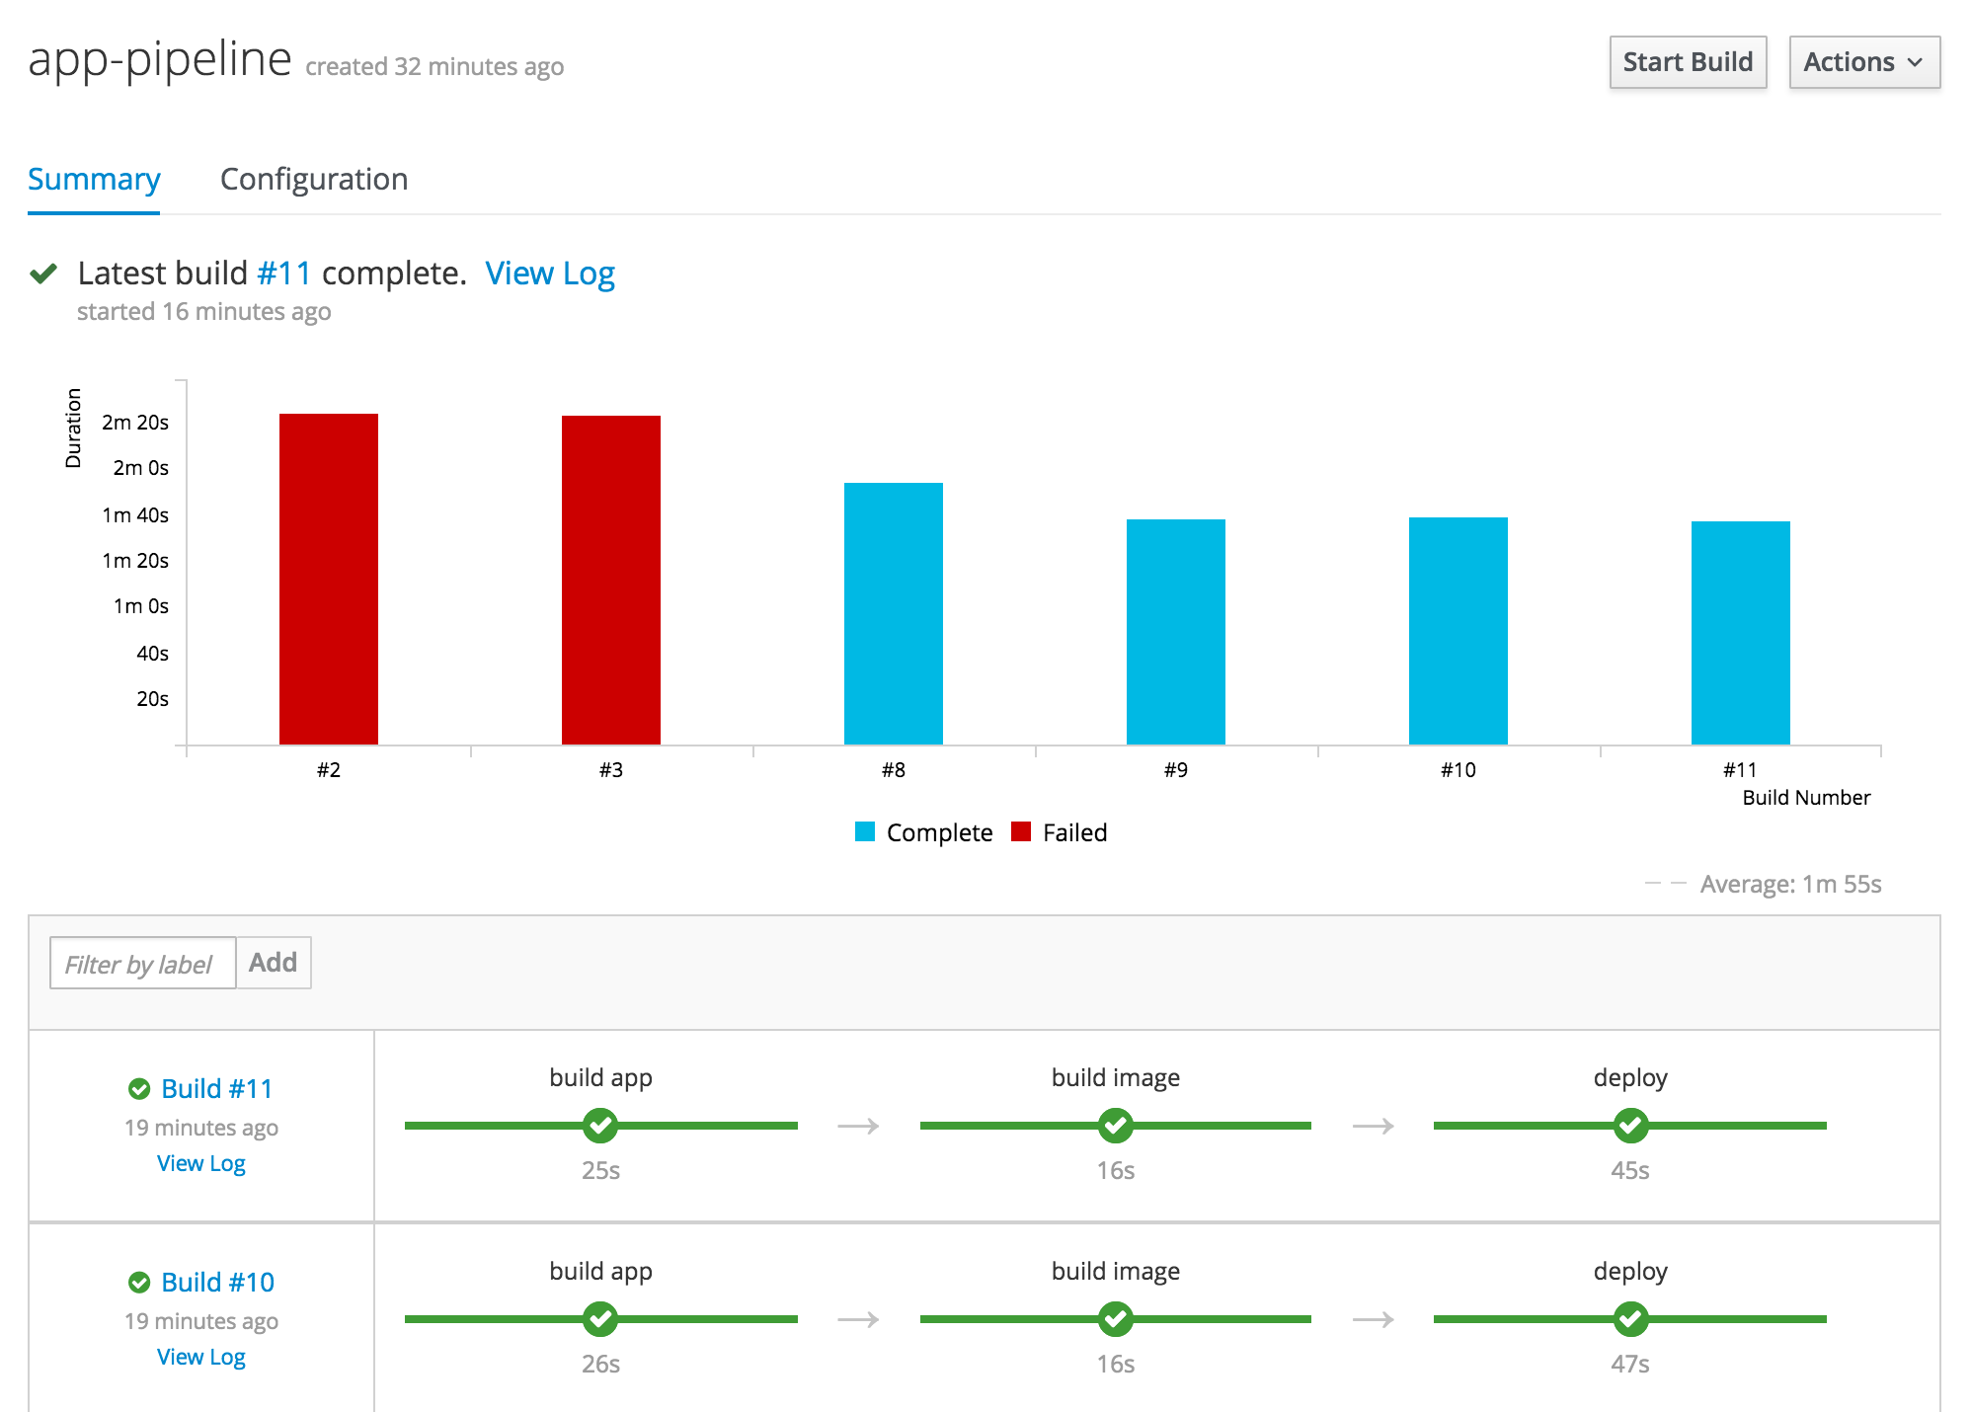
OpenShift Pipelines in
Web Console

Slide 133
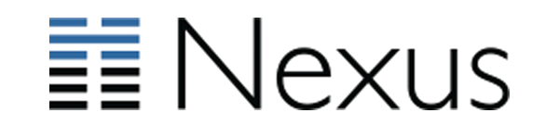


CONTINUOUS DELIVERY PIPELINE
DEV TEAM
GIT SERVER
ARTIFACT REPOSITORY
S2I build from source code
S2I build from app binary
Existing docker container image build process
JENKINS
IMAGE BUILD
APPLICATION
IMAGE
Notes:
The image build process in the pipeline could be any of the supported image build scenarios on OpenShift
Build from source code: OpenShift S2I takes application source code as an input and produce a new image that runs the assembled application as output
Build from application binaries: using the existing build process in the organization (e.g. Jenkins, Bamboo, TeamCity, Maven, Gradle, etc), dev teams can build the application binaries (e.g. JAR/WAR/EAR) from source code, store it in an artifact repository (e.g. Nexus, Artifactory, Archiva) and then use OpenShift S2I to take the app binaries as input and produce a new image that runs the assembled application as output
Build your own images: use your existing container image build process (Dockerfile, Ansible, etc) to build the application container images
After the image build process (regardless of which one your choose) produces the application images, the pipeline stores these images in an image registry. This registry might be
A third-party image registry like Docker Hub, Nexus, Artifactory, Quay, GitLab, Amazon ECR, etc
OpenShift standalone image registry
OpenShift integrated image registry
OpenShift can pull the application images from the third-party registries to the integrated registry (unless it’s already there!) and deploy the application containers onto the hosts. Pulling the images into OpenShift integrated registry allows OpenShift to monitor the upstream images for changes and redeploy the application images automatically whenever new versions are available.

Slide 134
CONTINUOUS DELIVERY PIPELINE
DEVELOPER
GIT SERVER
ARTIFACT REPOSITORY
OPENSHIFT
CI/CD PIPELINE
(JENKINS)
IMAGE BUILD
& DEPLOY
INTEGRATED
IMAGE
REGISTRY
INTEGRATED
IMAGE
REGISTRY
OPENSHIFT
CLUSTER
OPENSHIFT
CLUSTER
NON-PROD
DEV
PROD

Slide 135
CONTINUOUS DELIVERY PIPELINE
DEVELOPER
GIT SERVER
ARTIFACT REPOSITORY
OPENSHIFT
CI/CD PIPELINE
(JENKINS)
IMAGE BUILD
& DEPLOY
PROMOTE
TO TEST
INTEGRATED
IMAGE
REGISTRY
INTEGRATED
IMAGE
REGISTRY
OPENSHIFT
CLUSTER
OPENSHIFT
CLUSTER
NON-PROD
DEV
TEST
PROD

Slide 136
CONTINUOUS DELIVERY PIPELINE
DEVELOPER
GIT SERVER
ARTIFACT REPOSITORY
OPENSHIFT
CI/CD PIPELINE
(JENKINS)
IMAGE BUILD
& DEPLOY
PROMOTE
TO TEST
PROMOTE
TO UAT
INTEGRATED
IMAGE
REGISTRY
INTEGRATED
IMAGE
REGISTRY
OPENSHIFT
CLUSTER
OPENSHIFT
CLUSTER
NON-PROD
DEV
TEST
UAT
PROD

Slide 137
CONTINUOUS DELIVERY PIPELINE
DEVELOPER
GIT SERVER
ARTIFACT REPOSITORY
RELEASE MANAGER
ServiceNow
JIRA Service Desk Zendeks
BMC Remedy
GO LIVE?
OPENSHIFT
CI/CD PIPELINE
(JENKINS)
☒
☑
IMAGE BUILD
& DEPLOY
PROMOTE
TO TEST
PROMOTE
TO UAT
INTEGRATED
IMAGE
REGISTRY
INTEGRATED
IMAGE
REGISTRY
OPENSHIFT
CLUSTER
OPENSHIFT
CLUSTER
NON-PROD
DEV
TEST
UAT
PROD
Notes:
The deployment pipeline pauses for the approval of release manager, deployment manager, etc. This step is typically integrated into the existing IT workflow management system such as ServiceNow, JIRA Service Desk, etc so that eligible user groups receive notification when a deployment requires approval. They would in that case be able to log in into their IT workflow management dashboard and approve or reject the production deployment based on the provided deployment details.

Slide 138
CONTINUOUS DELIVERY PIPELINE
DEVELOPER
GIT SERVER
ARTIFACT REPOSITORY
RELEASE MANAGER
GO LIVE?
OPENSHIFT
CI/CD PIPELINE
(JENKINS)
☒ ☑
IMAGE BUILD
& DEPLOY
PROMOTE
TO TEST
PROMOTE
TO UAT
PROMOTE
TO PROD
INTEGRATED
IMAGE
REGISTRY
INTEGRATED
IMAGE
REGISTRY
OPENSHIFT
CLUSTER
OPENSHIFT
CLUSTER
NON-PROD
DEV
TEST
UAT
PROD

Slide 139
DEVELOPER WORKFLOW

Slide 140

LOCAL DEVELOPMENT WORKFLOW
Bootstrap
Develop
Local
Deploy
Verify
Git Push
Pipeline
Notes:
Local development workflow describes the process of writing code and testing it locally on a development workstation. Although the local development workflow varies a lot from between teams and organizations, the current slide presents a common workflows used with OpenShift.

Slide 141
LOCAL DEVELOPMENT WORKFLOW
Bootstrap
Develop
Local
Deploy
Verify
Git Push
Pipeline
BOOTSTRAP
Pick your programming language and application runtime of choice
Create the project skeleton from scratch or use a generator such as
Maven archetypes
Quickstarts and Templates
OpenShift Generator
Spring Initializr

Slide 142
LOCAL DEVELOPMENT WORKFLOW
Bootstrap
Develop
Local
Deploy
Verify
Git Push
Pipeline
DEVELOP
Pick your framework of choice such as Java EE, Spring, Ruby on Rails, Django, Express, ...
Develop your application code using your editor or IDE of choice
Build and test your application code locally using your build tools
Create or generate OpenShift templates or Kubernetes objects

Slide 143
LOCAL DEVELOPMENT WORKFLOW
Bootstrap
Develop
Local
Deploy
Verify
Git Push
Pipeline
LOCAL DEPLOY
Deploy your code on a local OpenShift cluster
Red Hat Container Development Kit (CDK), minishift and oc cluster
Red Hat CDK provides a standard RHEL-based development environment
Use binary deploy, maven or CLI rsync to push code or app binary directly into containers
Notes:
CDK, minishift and oc cluster are all available on MacOS, Windows and Linux
Binary deploy and rsync allow pushing code and application binary into the container without the need to push the code to the Git repository in order to test the application

Slide 144
LOCAL DEVELOPMENT WORKFLOW
Bootstrap
Develop
Local
Deploy
Verify
Git Push
Pipeline
VERIFY
Verify your code is working as expected
Run any type of tests that are required with or without other components (database, etc)
Based on the test results, change code, deploy, verify and repeat

Slide 145
LOCAL DEVELOPMENT WORKFLOW
Bootstrap
Develop
Local
Deploy
Verify
Git Push
Pipeline
GIT PUSH
Push the code and configuration to the Git repository
If using Fork & Pull Request workflow, create a Pull Request
If using code review workflow, participate in code review discussions

Slide 146
LOCAL DEVELOPMENT WORKFLOW
Bootstrap
Develop
Local
Deploy
Verify
Git Push
Pipeline
PIPELINE
Pushing code to the Git repository triggers one or multiple deployment pipelines
Design your pipelines based on your development workflow e.g. test the pull request
Failure in the pipeline? Go back to the code and start again

Slide 147
APPLICATION SERVICES

Slide 148
A PLATFORM THAT GROWS WITH YOUR BUSINESS
Web
Application
Data Virtualization
Intelligent
Process
Micro services
API
Management
Single
Sign-On
Java EE Application
Mobile
Integration
Messaging
Data Grid
Real Time Decision

Slide 149
TRUE POLYGLOT PLATFORM
Java
NodeJS
Python
PHP
Perl
Ruby
.NET
Core
Third-party Language Runtimes
LANGUAGES
MySQL
Redis
...and virtually any docker image
out there!
Third-party Databases
DATABASES
PostgreSQL
MongoDB
CrunchyData
GitLab
Iron.io
Couchbase
Sonatype
EnterpriseDB NuoDB Fujitsu
and many more
Apache HTTP
Server
nginx
Varnish
Phusion Passenger
Tomcat
Third-party App Runtimes
WEB SERVERS
Spring Boot
Wildfly Swarm
Vert.x
JBoss
Web Server
JBoss
EAP
JBoss
A-MQ
JBoss
Fuse
Third-party Middleware
MIDDLEWARE
3SCALE
API mgmt
JBoss
BRMS
JBoss
BPMS
JBoss
Data Virt
JBoss
Data Grid
RH Mobile
RH SSO
Third-party Middleware
Notes:
All listed images are certified docker images shipped with OpenShift and are supported by Red Hat

Slide 150

TESTED AND VERIFIED MICROSERVICES FRAMEWORKS
LAUNCH
Spring Boot
Netflix Hystrix
Netflix Ribbon
SUPPORTED MICROSERVICES RUNTIMES
Reactive
Eclipse Vert.x
MicroProfile
WildFly Swarm
Server-side JS
Node.js
Java EE
JBoss EAP
Java EE Web
Embedded Tomcat
Modern, Cloud-Native Application Runtimes and an Opinionated Developer Experience
Notes:
Red Hat OpenShift Application Runtimes is an offering that gives you a path from where you are today, being on a Java EE application server with Java EE stack or Spring, to what you need to be able to build and run your services as cloud-native microservices.
RHOAR provides two groups of runtimes. The supported runtimes are fully supported by Red Hat and we provide full lifecycle management for them such as JBoss EAP, WildFly Swarm, Vert.x (only Java lang) and Node.js. The other group of frameworks are what Red Hat tested and verified to make sure they run smoothly on OpenShift such as Spring Boot, some parts of Spring Cloud, Netflix Hystrix and Ribbon. As we go forward, we take more parts of Spring Cloud and certify them on OpenShift.
RHOAR also provides a launchpad which is a project generator based on a collection of cloud-native samples using the microservices runtimes supported and tested in RHOAR
Furthermore, RHOAR provides tight integration between these runtimes and frameworks regardless of if they are supported or certified, with OpenShift and Kubernetes to be able to not only run them smoothly on OpenShift but also it takes advantage of the container capabilities provided in OpenShift to simplify scaling, configuration, management and operations of these services.

Slide 151
MICROSERVICES
INFRASTRUCTURE:
ISTIO SERVICE MESH

Slide 152
WHAT YOU NEED FOR MICROSERVICES?
Visibility & Reporting
Resilience & Fault Tolerance
Routing & Traffic Control
Identity & Security
Policy Enforcement
Notes:
Visibility and Reporting: Gain understanding of the dependencies between services and the nature and flow of traffic between them, providing the ability to quickly identify issues.
Resilience and Fault Tolerance: protect services against cascading failures by invocation timeouts, retries, throttling, health checks and circuit breakers
Routing and Traffic Control: Control the flow of traffic and API calls between services, make calls more reliable, and make the network more robust in the face of adverse conditions.
Service Identity and Security. Provide services in the mesh with a verifiable identity and provide the ability to protect service traffic as it flows over networks of varying degrees of trustability.
Policy Enforcement: Apply organizational policy to the interaction between services, ensure access policies are enforced and resources are fairly distributed among consumers. Policy changes are made by configuring the mesh, not by changing application code.

Slide 153

WHAT YOU NEED FOR MICROSERVICES?
Visibility & Reporting
Resilience & Fault Tolerance
Istio
Routing & Traffic Control
Identity & Security
Policy Enforcement
Notes:
Istio provides an easy way to create a network of deployed services with load balancing, service-to-service authentication, monitoring, and more, without requiring any changes in service code.

Slide 154


WHAT IS ISTIO?
a service mesh to connect, manage, and secure microservices
Control
Plane
Pilot
Mixer
Auth
Data
Plane
Pod
Pod
Pod
Pod
Envoy
Envoy
Envoy
Envoy
App
App
App
App
COMING SOON
Notes:
An Istio service mesh is logically split into a data plane and a control plane.
The data plane is composed of a set of intelligent proxies (Envoy) deployed as sidecars that mediate and control all network communication between microservices.
The control plane is responsible for managing and configuring proxies to route traffic, as well as enforcing policies at runtime.
The control plane is composed of three components:
Mixer: enforcing access control and usage policies across the service mesh and collecting telemetry data
Auth: service-to-service and end-user authentication
Pilot: traffic management capabilities for intelligent routing (e.g., A/B tests, canary deployments, etc.), and resiliency (timeouts, retries, circuit breakers, etc.)

